Slide 1
Managing Debt After College
Presented by
A Financial Beginnings Financial Education Program
Notes:
Introduce yourself to the students. Let students know that you are volunteering your time with Financial Beginnings to share with them this important lesson.

Slide 2
What plans to do you have once you have completed school?
Notes:
Engage students with an icebreaker. Find out what students’ post school plans are.

Slide 3
What are we doing today?
We will:
Take a realistic look at post-college living expenses
Create a budget for post-college life
Learn about loan restructuring and consolidation options
Discuss how to set long-term financial goals that incorporate saving and debt management
Notes:
Review the objectives of the session.

Slide 4
How much money do you think you’ll make annually?
Notes:
Based on their education and the position they plan to have what do students feel their average salary will be? We are looking for average once they are established, not right out of college.

Slide 5
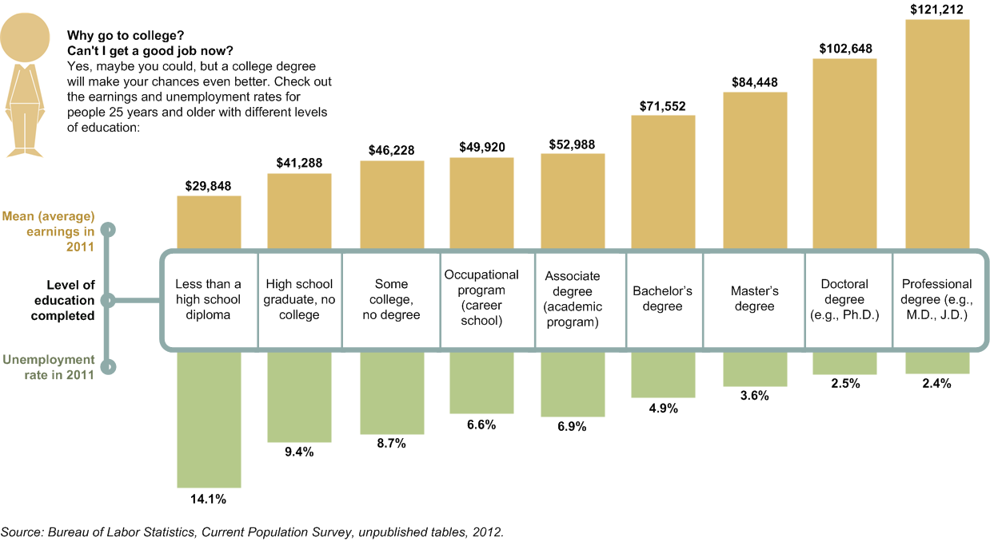
Nationally
Notes:
Students are likely aware of the benefit of investing in their education.
How do you think Oregon compares to the national average?

Slide 6
So how much will you make in your lifetime?
Average salary of an undergraduate is $71,552
Assuming you work 40 years you would earn….
$2,862,080
Still nearly half of Americans die with less than $10,000
Notes:
Calculating $71,552 by 40 years.

Slide 7
Where do our millions go?
$224,690 on Food
$121,212 for Cars
$250,000 for housing
$171,816 for College
$94,560 for Retirement
$600,000 for Interest Payments
$256,049 for Taxes
And what about things like vacations, braces, clothing…….
Notes:
Though it may seem like you will make a lot of money, you are also going to spend a lot of money. When you start to add up the line items in your budget over decades the dollars add up.

Slide 8
Will you start your career at the average salary?
Average starting salary for an undergraduate is $44,000
Notes:
Make sure students understand that it takes years to get up to the average salary for their field. The average salary for a recent undergrad is $44,000.

Slide 9
Post Graduation Budget
Activity
Notes:
Direct students to the Post Graduation Budget Activity. Allow students time to work individually or in pairs on the activity. You will need to print out enough copies of this before class.
The next slide will provide you with answers and the follow slide will have review questions for the activity.

Slide 10
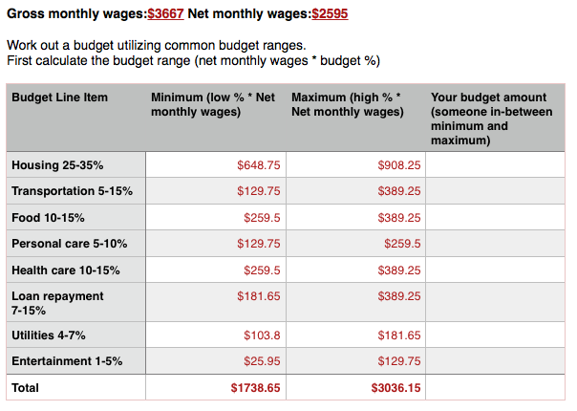
Post Graduation Budget
Notes:
Here is the answer key for the Post Graduation Budget Activity.

Slide 11
Post Graduation Budget
What did your total monthly expenses add up to?
Were there any budget line items you would spend more or less on?
How much do you have available for savings? What will you be saving for?
Notes:
Here are review questions to go over with the students to delve deeper into the activity.

Slide 12
Understanding Your Loans
Federal Student Loans- The US Department of Education funds or insures.
Private Student Loans- These loans are nonfederal loans that are made by a bank, credit union, state agency or school.
Direct Subsidized Loans
Direct Unsubsidized Loans
Direct PLUS Loans for Parents
Direct PLUS loans for Grad or Professional Students
Perkins Loans
Direct Consolidated Loans
Federal Student Loans
Not sure which type of loans you have? www.NSLDSFAP.ed.gov
SOURCE: U.S. Department of Education 2013
Notes:
A Federal Student Loan is a loan funded by the federal government to help pay for your education. A federal student loan is borrowed money you must repay with interest.
A Private Student Loan is a private loan made by a lender such as a bank, credit union, state agency or school and must also be repaid with interest.
The William D. Ford Federal Direct Loan Program is the largest federal student loan program. Under this program, the U.S. Department of Education is your lender. There are four types of Direct Loans available:
Direct Subsidized Loans are loans made to eligible undergraduate students who demonstrate financial need to help cover the costs of higher education at a college or career school.
Direct Unsubsidized Loans are loans made to eligible undergraduate, graduate, and professional students, but in this case, the student does not have to demonstrate financial need to be eligible for the loan.
Direct PLUS Loans are loans made to graduate or professional students and parents of dependent undergraduate students to help pay for education expenses not covered by other financial aid.
Direct Consolidation Loans allow you to combine all of your eligible federal student loans into a single loan with single loan servicer.
The Federal Perkins Loan Program is a school-based loan program for undergraduates and graduate students with exceptional financial need. Under this program, the school is the lender.

Slide 13
When must I begin making payments?
Most student loan payments begin 6 months after graduation or when you drop below half-time
PLUS loans have no grace period
Paying interest while in school can help to keep loans low
You can estimate your monthly payments at:
http://www.finaid.org/calculators/loanpayments.phtml
https://studentloans.gov/myDirectLoan/mobile/repayment/repaymentEstimator.action
Notes:
Direct Subsidized Loans, Direct Unsubsidized Loans, Subsidized Federal Stafford Loans, and Unsubsidized Federal Stafford Loans have a six-month grace period before payments are due.
PLUS loans have no grace period. They enter repayment once they are fully disbursed but may be eligible for a deferment. Contact your loan servicer for more information.
If you received a Federal Perkins Loan, check with the school where you received the loan.
The finaid.org site provides an easy general calculator. The studentloans.gov can actually use your information and provide repayment options for your specific loans.

Slide 14
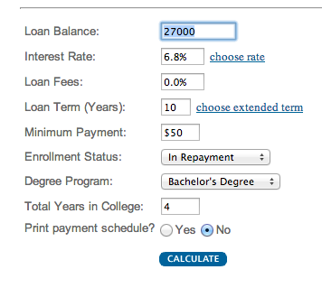
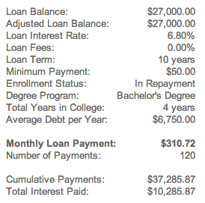
Using the calculator
Notes:
Assume that you leave school with $27,000 in student loan debt. You estimated payment would be about $310 each month.

Slide 15
My payment is what!?!?
Options:
Change repayment plans
Deferment or Forbearance
Forgiveness, Cancelation or Discharge
Notes:
For many graduates their student loan payment is too high for their initial out of school budget. In the coming slides we will review each of these options in detail.

Slide 16
Standard Repayment Plan
Eligible Loans
Direct Subsidized & Unsubsidized
Subsidized & Unsubsidized Federal Stafford Loans
Money Payment & Time Frame
Payments are fixed
Up to 10 years
Quick Comparison
Pay less interest than other plans
All PLUS loans
SOURCE: U.S. Department of Education 2013
Notes:
Eligible Loans
Direct subsidized and Unsubsidized Loans
Subsidized and Unsubsidized Federal Stafford Loans
All PLUS loans
Monthly Payment & Time Frame
Payments are a fixed amount of at least $50 per month.
Up to 10 years
Quick Comparison
You’ll pay less interest for your loan over time under this plan than you would under other plans.
https://studentaid.ed.gov/repay-loans/understand/plans

Slide 17
Graduated Repayment Plan
Eligible Loans
Direct Subsidized & Unsubsidized
Subsidized & Unsubsidized Federal Stafford Loans
Money Payment & Time Frame
Payments lower at first & increase every 2 years
Up to 10 years
Quick Comparison
More interest paid than the standard
All PLUS loans
SOURCE: U.S. Department of Education 2013
Notes:
Eligible Loans
Direct subsidized and Unsubsidized Loans
Subsidized and Unsubsidized Federal Stafford Loans
All PLUS loans
Monthly Payment & Time Frame
Payments are lower at first and then increase, usually every two years
Up to 10 years
Quick Comparison
You’ll pay more for your loan over time than under the 10-year standard plan.
https://studentaid.ed.gov/repay-loans/understand/plans

Slide 18
Extended Repayment Plan
Eligible Loans
Direct Subsidized & Unsubsidized
Subsidized & Unsubsidized Federal Stafford Loans
Money Payment & Time Frame
Payments lower at first & increase every 2 years
Up to 10 years
Quick Comparison
More interest paid than the standard
All PLUS loans
SOURCE: U.S. Department of Education 2013
Notes:
Eligible Loans
Direct subsidized and Unsubsidized Loans
Subsidized and Unsubsidized Federal Stafford Loans
All PLUS loans
Monthly Payment & Time Frame
Payments may be fixed or graduated
Up to 25 years
Quick Comparison
Your monthly payment would be lower than the 10-year standard plan
You have more than 30,000 in outstanding loans
For both programs, you must also be a new borrower as of Oct 1998
You’ll pay more for your loan over time than under the 10-year standard plan
https://studentaid.ed.gov/repay-loans/understand/plans

Slide 19
Income-Based Repayment Plan
Eligible Loans
Direct Subsidized & Unsubsidized
Subsidized & Unsubsidized Federal Stafford Loans
Money Payment & Time Frame
Max of 15% of your income
Up to 25 years
Quick Comparison
Must have financial hardship
All PLUS loans made to students
Consolidation Loans
Payments adjusted with income
Lower payments
More interest paid
Possibility of forgiveness after 25 years
SOURCE: U.S. Department of Education 2013
Notes:
Eligible Loans
Direct subsidized and Unsubsidized Loans
Subsidized and Unsubsidized Federal Stafford Loans
All PLUS loans made to students
Consolidation Loans (Direct or FFEL) that do not include Direct or FFEL PLUS loans made to parents
Monthly Payment & Time Frame
Your maximum monthly payments will be 15% of discretionary income, the difference between your adjusted gross income and 150% of the poverty guideline for your family size and state of residence.
Your payments change as your income changes.
Up to 25 years
Quick Comparison
You must have a partial financial hardship
Your monthly payments will be lower than payments under the 10-year standard plan
You’ll pay more for your loan over time than you would under the 10-year standard plan
If you have not repaid your loan in full after making the equivalent of 25 years of qualifying monthly payments, any outstanding balance on your loan will be forgiven
You may have to pay income tax on any amount that is forgiven.
https://studentaid.ed.gov/repay-loans/understand/plans

Slide 20
Pay As You Earn Repayment Plan
Eligible Loans
Direct Subsidized & Unsubsidized
Direct PLUS loans to students
Money Payment & Time Frame
Max of 10% of your discretionary income
Up to 20 years
Quick Comparison
Must have financial hardship
Direct Consolidation Loans
Payments adjusted with income
Lower payments
More interest paid
Possibility of forgiveness after 20 years
SOURCE: U.S. Department of Education 2013
Notes:
Eligible Loans
Direct subsidized and Unsubsidized Loans
Direct PLUS loans made to students
Direct consolidation loans that do not include (Direct or FFEL) PLUS loans made to parents
Monthly Payment & Time Frame
Your maximum monthly payments will be 10% of discretionary income, the difference between your adjusted gross income and 150% of the poverty guideline for your family size and state of residence
Your payments change as your income changes
Up to 20 years
Quick Comparison
You must be a new borrower on or after Oct 2007, and must have received disbursement of a Direct Loan on or after Oct 2011
You must have a partial financial hardship
Your monthly payments will be lower than payments under the 10-year standard plan
You’ll pay more for your loan over time than you would under the 10-year standard plan
If you have not repaid your loan in full after you made the equivalent of 20 years of qualifying monthly payments, any outstanding balance on your loan will be forgiven
You may have to pay income tax on any amount that is forgiven
https://studentaid.ed.gov/repay-loans/understand/plans

Slide 21
Income-Contingent Repayment Plan
Eligible Loans
Direct Subsidized & Unsubsidized
Subsidized & Unsubsidized Federal Stafford Loans
Money Payment & Time Frame
Based on income, family size and loan amount
Up to 25 years
Quick Comparison
Consolidation Loans
Payments adjusted with income
More interest paid
Possibility of forgiveness after 25 years
SOURCE: U.S. Department of Education 2013
Notes:
Eligible Loans
Direct Subsidized and Unsubsidized Loans
Direct PLUS Loans made to students
Direct consolidation Loans
Monthly Payment & Time Frame
Payments are calculated each year and are based on your adjusted gross income, family size and the total amount of your Direct Loans
Your payments change as your income changes
Up to 25 years
Quick Comparison
You’ll pay more for your loan over time than under the 10-year standard plan
If you do not repay your loan after making the equivalent of 25 years of qualifying monthly payments, the unpaid portion will be forgiven
You may have to pay income taxes on the amount that is forgiven
https://studentaid.ed.gov/repay-loans/understand/plans

Slide 22
Income- Sensitive Repayment Plan
Eligible Loans
Direct Subsidized & Unsubsidized Federal Stafford
Money Payment & Time Frame
Based on income
Up to 10 years
Quick Comparison
More interest paid
FFEL PLUS
FFEL Consolidation
Payments adjusted with income
SOURCE: U.S. Department of Education 2013
Notes:
Eligible Loans
Subsidized and Unsubsidized Federal Stafford Loans
FFEL PLUS loans
FFEL Consolidation Loans
Monthly Payment & Time Frame
Payments are based on annual income
Payments change as your income changes
Up to 10 years
Quick Comparison
You’ll pay more for your loan over time than under the 10-year standard plan
Each lender’s formula for determining the monthly payment amount under the plan can vary
https://studentaid.ed.gov/repay-loans/understand/plans

Slide 23
Loan Consolidation Activity
Notes:
Direct students to the Loan Consolidation Activity. Allow students time to work individually or in pairs on the activity. You will need to print out enough copies of this before class.
The next slide will provide you with answers for the activity.

Slide 24
Loan Consolidation Activity
Current
Payment $281.01
Interest 6.3%
Consolidation
Payment $183.20
Interest 6.8%
Total Interest $9,921.20
Total Interest $19,986
Consolidate?
Payment decrease $97.81
Increased rate of .5%
Increase Interest of $10,264.80
Notes:
Here is an overview of the answers and the comparison. Lead a discussion with students to find out if they would find the decreased payment of $97 each month to be worth the increased interest over the life of the loan of $10,264.

Slide 25
Things to watch for
Payment
Loan Terms
Interest Rate
Total Interest
Loan Maturity
Or Not?
Consolidate?
Notes:
It is important to be sure and carefully review the terms of the loan before consolidating. You may just be interested in the monthly payment, but it’s important to consider how much interest your are going to be paying over the life of the loan and any other terms specific to the loan.

Slide 26
Deferment or Forbearance
Deferment
Forbearance
Unemployment
Economic hardship
Graduate fellowship
Rehabilitation training program
Military
In-school
Medical/dental internship residency
Student loan debt burden
AmeriCorps
National Guard
Notes:
A deferment is a period during which repayment of the principal and interest of your loan is temporarily delayed.
If you are unemployed and looking for a job
During a period of economic hardship (includes Peace Corps service)
If you take part in an approved graduate fellowship program
If you are in an approved rehabilitation training program for the disabled
During a period of active duty military service during a war, military operation, or national emergency
If you are in school at least half-time
If you can’t make your scheduled loan payments, but don’t qualify for a deferment, your loan services may be able to grant you a forbearance. With forbearance, you may be able to stop making payments or reduce your monthly payment for up to 12 months.
You are serving as a medical or dental internship or residency program
If your total amount of student loans is 20% or more of your total monthly gross income
You are serving in a national service position such as AmeriCorp

Slide 27
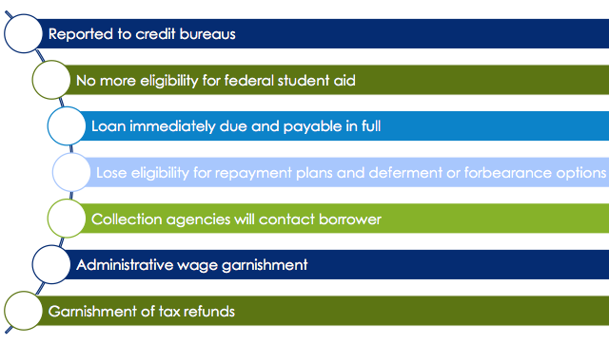
Consequences of Default
Notes:
For many their first exposure to debt is student loans. It is important to understand the consequences of defaulting on student loans (or any other debt). Loan default can have a lasting negative effect.

Slide 28
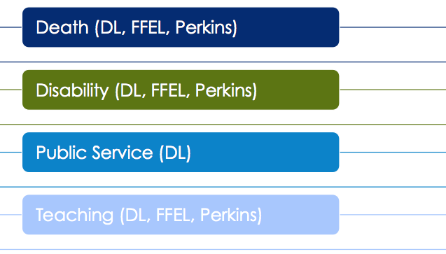
Forgiveness, Cancelation or Discharge
Notes:
Death- If you die, your student loan debt will be discharged. If your parents took out a PLUS loan and either they die or you do, then they will also be discharged.
Disability- Direct loans may be discharged if you become totally and permanently disabled.
Public Service- Certain public service jobs can qualify you for loan forgiveness after 120 payments. You do have to make the payments under certain payment plans.
Teacher- If you teach full-time in a low-income elementary or secondary school for five consecutive years you can get up to $17,500 forgiven.

Slide 29
Setting Financial Goals
Plans for next 5-10 years
Possible Cost
Get married?
Buy a house?
Buy a car?
Have children?
Go back to school?
$25,000
$50,000 down payment
$20,000
$800 per month
$30,000-50,000
Notes:
It is important to keep in mind your future financial goals. You likely have a lot of plans for the next several years and want to ensure that you are planning accordingly.

Slide 30
Starting Off Strong
Set Financial Goals
Minimize Debt Accumulation
Start Saving Early
Rinse and Repeat
Be a Lifelong Learner
Notes:
Set financial goals- First and foremost you want to set your financial goals. Include dollar amounts to meet the goals.
Minimize debt accumulation- debt can bog you down and keep you from reaching your future goals. It’s important to only take out debt that makes sense. Every time you take out debt you have a realistic plan to pay it back.
Start saving early- Time is the most valuable asset on your side right now. Starting early with your savings will help you to reach your long term financial goals, like retirement. If your employer provides you the option to participate in a retirement plan, like a 401k, be sure to take advantage of it. Many times employers will match funds that you contribute, which essentially doubles your savings.
Be a lifelong learner- You may think you are finished learning, but this is only the beginning. It is important to continue to further your knowledge. This is especially important when it comes to financial matters because they change so fast.
Rinse and repeat- Your plan now is not going to be your plan in the future. You have to be sure to review your goals and financial situation regularly to make sure you are on track.

Slide 31
Got it?
Can you:
Take a realistic look at post-college living expenses?
Create a budget for post-college life?
Understand loan restructuring and consolidation options?
Set long-term financial goals that incorporate saving and debt management?
Notes:
Review the course objectives and answer any remaining questions students may have.

