Slide 1

Welcome
COUNTRY Financial® proudly provides financial literacy education to your classroom.
Financial literacy is important, no matter how old you are and
no matter your goals. Understanding money allows you to make
more informed choices and to be better able to pursue your
dreams. Congratulations on taking this first step in becoming
more financially savvy.
Sponsored by

Slide 2
Budgeting
A Financial Beginnings financial education program
© Financial Beginnings, 2015

Slide 3
What if you won the lottery?
How would you spend the money?
Notes:
We have all day dreamed one time or another about what we would do if we won millions in the lottery. This warm-up exercise is great to get the students excited about what they would do if they won the lottery. Common responses are:
Buy a house
Buy a car
Go to college
Invest the money
Help out family members
Donate
Travel
Start a business
You will likely notice one answer that does not appear with younger participants, but is probably included if you are presenting to a crowd over 18…pay off debt! This is one of the great aspects of our programs and the lesson. We can help students to budget and limit the amount of debt they have.
After students have made their exhaustive lists of things they would like to do if they won the lottery, you can pose the question “Is there any reason you cannot do these things anyway?” One by one you can discuss the list and explain how all of these things can be achieved without winning the lottery, but budgeting is a key to making them happen.

Slide 4
What are we doing today?
We will:
  Learn the primary components of a budget and how one can be created and maintained.
  Learn about the different types of income and how taxes apply.
  Learn about some useful budgeting concepts such as fixed and variable expenses.
  Learn how short-term and long-term financial goals are set and utilized.
  Learn tips to keeping your budget relevant.
Notes:
Budgeting Session Objectives

Slide 5
What is a budget?
Who uses budgets?
Notes:
A budget is a summary of your planned expenses compared with your planned income, for a pre-determined time period.
“Why develop a budget?”
As you get older your income and expenses will grow, in terms of both dollars and complexity.
Large purchases (like a car, college or house) cannot be made spontaneously- they require a plan to pay for them.
A budget provides a plan for your money so you can attain your goals.
A budget helps you to track your spending and ensure that you are living within your means.

Slide 6
Basics of Budgets
Income
Earned
Portfolio
Gifted or borrowed
Expenses
Fixed
Variable
Net Income or Loss
Surplus or
Shortfall
Notes:
There are three basic components of a budget.
You pick the time period, like monthly or by pay period. It can be helpful to also do an annual budget because some expenses are not paid monthly.
Income – expenses = net income or loss
If your number is positive, there is money available for savings
If you number is negative, then you are going into debt!

Slide 7
Income
Earned
Portfolio
Gifted/Loaned
Notes:
Earned income-
Job
Consulting
Operating a business
Portfolio income-
Stock returns
Bond returns
Rental income
Gifted/borrowed-
Birthday
Christmas
Student loans while in school

Slide 8
Expenses
Fixed
Rent
Car insurance
Variable
Food
Clothing
Loan payments
Phone bill
Gas
Taxes
Entertainment
Notes:
Common expenses-
Auto
Clothing
Cell phone
Internet
Food
Housing
Insurance
Loans
Fixed expenses are those that do not change.
Variable expenses change from month to month.

Slide 9
Taxes
Income
Federal
Sales
General purchases
Asset
Real Estate
Excise
Gas
State
City
FICA
Luxury items
Stocks
Cigarettes
Travel
Food purchases
Notes:
Taxes are an expense. We pay for taxes in several different ways.

Slide 10
Factoring taxes into your budget
Decide if you are budgeting for Gross or Net income
Budget for taxes
Understand how your W4 effects the taxes withheld from your paycheck

Slide 11
Needs vs. Wants
Need
Want
Notes:
Money is emotional. It’s usually very easy to understand what we “should” do, but our emotions and urges can get us into trouble, especially with money. It is important for us to understand the difference between needs and wants and understand they vary from person to person.
Fun Activity-
Have students stand up in the middle of the room.
Tell students that one end of the room represents something they need and the other end something they want.
Let them know that they are likely going to be somewhere in between for each of the items you are going to list.
Tell them to stand in a the place they feel their needs and wants are for the item you mention.
Items:
Morning coffee
Professional hair cut
A fancy car
Many pairs of shoes
Name brand jeans
An awesome game system

Slide 12
Maslow’s Hierarchy of Needs
Love, belonging
Safety
Physiological
Acceptance
Self-esteem
Notes:
Maslow’s Hierarchy of Needs allows us to put our needs into perspective.
Physiological- covers absolute needs like water and food.
You need food, but you don’t need to eat out everyday. Packing your lunch can be a big cost saver.
You need water, but purchasing water at the machine can get expensive.
Safety- provides you with protection, like shelter and an income to support yourself.
You need a roof over your head, but do you need to live by yourself. Getting a roommate can help save costs.
If you find your income in not enough to support you, is there a way of increasing it?
Love, Belong- the need to be loved and belong to a group.
Love is actually free. If you find that you are having to pay to keep a girlfriend/boyfriend or friends, you might want to rethink them.
Self-esteem- needing to feel respected by others and feel achievement.
Self-esteem, though higher up on the pyramid, it is one of the areas that we spend a lot on. We feel the need to look good, so we buy the latest brands or spend lots on grooming. It’s important to remember that we need to make sure that we are meeting the previous needs first before blowing our budget on our self-esteem.
Acceptance- realizing your potential
It’s important to understand that you can reach this point without having a lot of money.

Slide 13
Social
Economic
Environmental
Responsibility
Notes:
There may be some responsibility factors that we need to factor into our budget and as our life changes we may feel our sense of responsibility also changing.
Economic Responsibility- Is it important to you to shop local? Support small businesses?
Social Responsibility- Is is important that you buy American made products? Shop at retailers that have similar beliefs?
Environmental Responsibility- Is it important that you purchase organic? Locally sourced? Biodegradable products?

Slide 14

Where can I cut expenses?
Notes:
If you are looking to decrease expenses, you’ll likely want to first start with the variable expenses. It’s much easier to decrease for gas use than it is to decrease your car payment.
“What are some ideas you have for cutting back on our day to day expenses?”
Focus on major cost drivers
Save money on food:
Use store brands vs. national brands.
Shop at low-cost retailers.
Use coupons.
Limit eating out.
Save money on transportation:
Combine insurance policies for a discount.
Use public transportation or bicycle.
Use fuel efficient vehicle.
Consider a car sharing program.
Save money on entertainment:
Discount offers like Groupon.
Ditch cable for less expensive alternatives.
Travel at off peak times.

Slide 15
Case: Cheryl
What are some ways that Cheryl can cut down on her expenses so that she can afford to take the vacation with her family?
Page 4 of the Resource Guide
Notes:
Refer students to page 4 of the Resource Guide to work through the Cheryl case. Then come back as a group to discuss some ways to help Cheryl’s budget.
Below are a few ideas to help Cheryl reach her goal:
Cheryl seems to have good credit because she pays her bills on time. She could call the credit card company to see if they could lower her interest rate or explore other cards with a lower interest rate.
Maybe Danny and LaTonya’s parents could pay Cheryl for watching their kids after school.
She should stop shopping on her lunch break.

Slide 16
How to start a budget
Pick a time period
Project your income and expenses
Calculate income – expenses
Income needs to exceed expenses
Income
Expenses
Net Income/
Loss

Slide 17
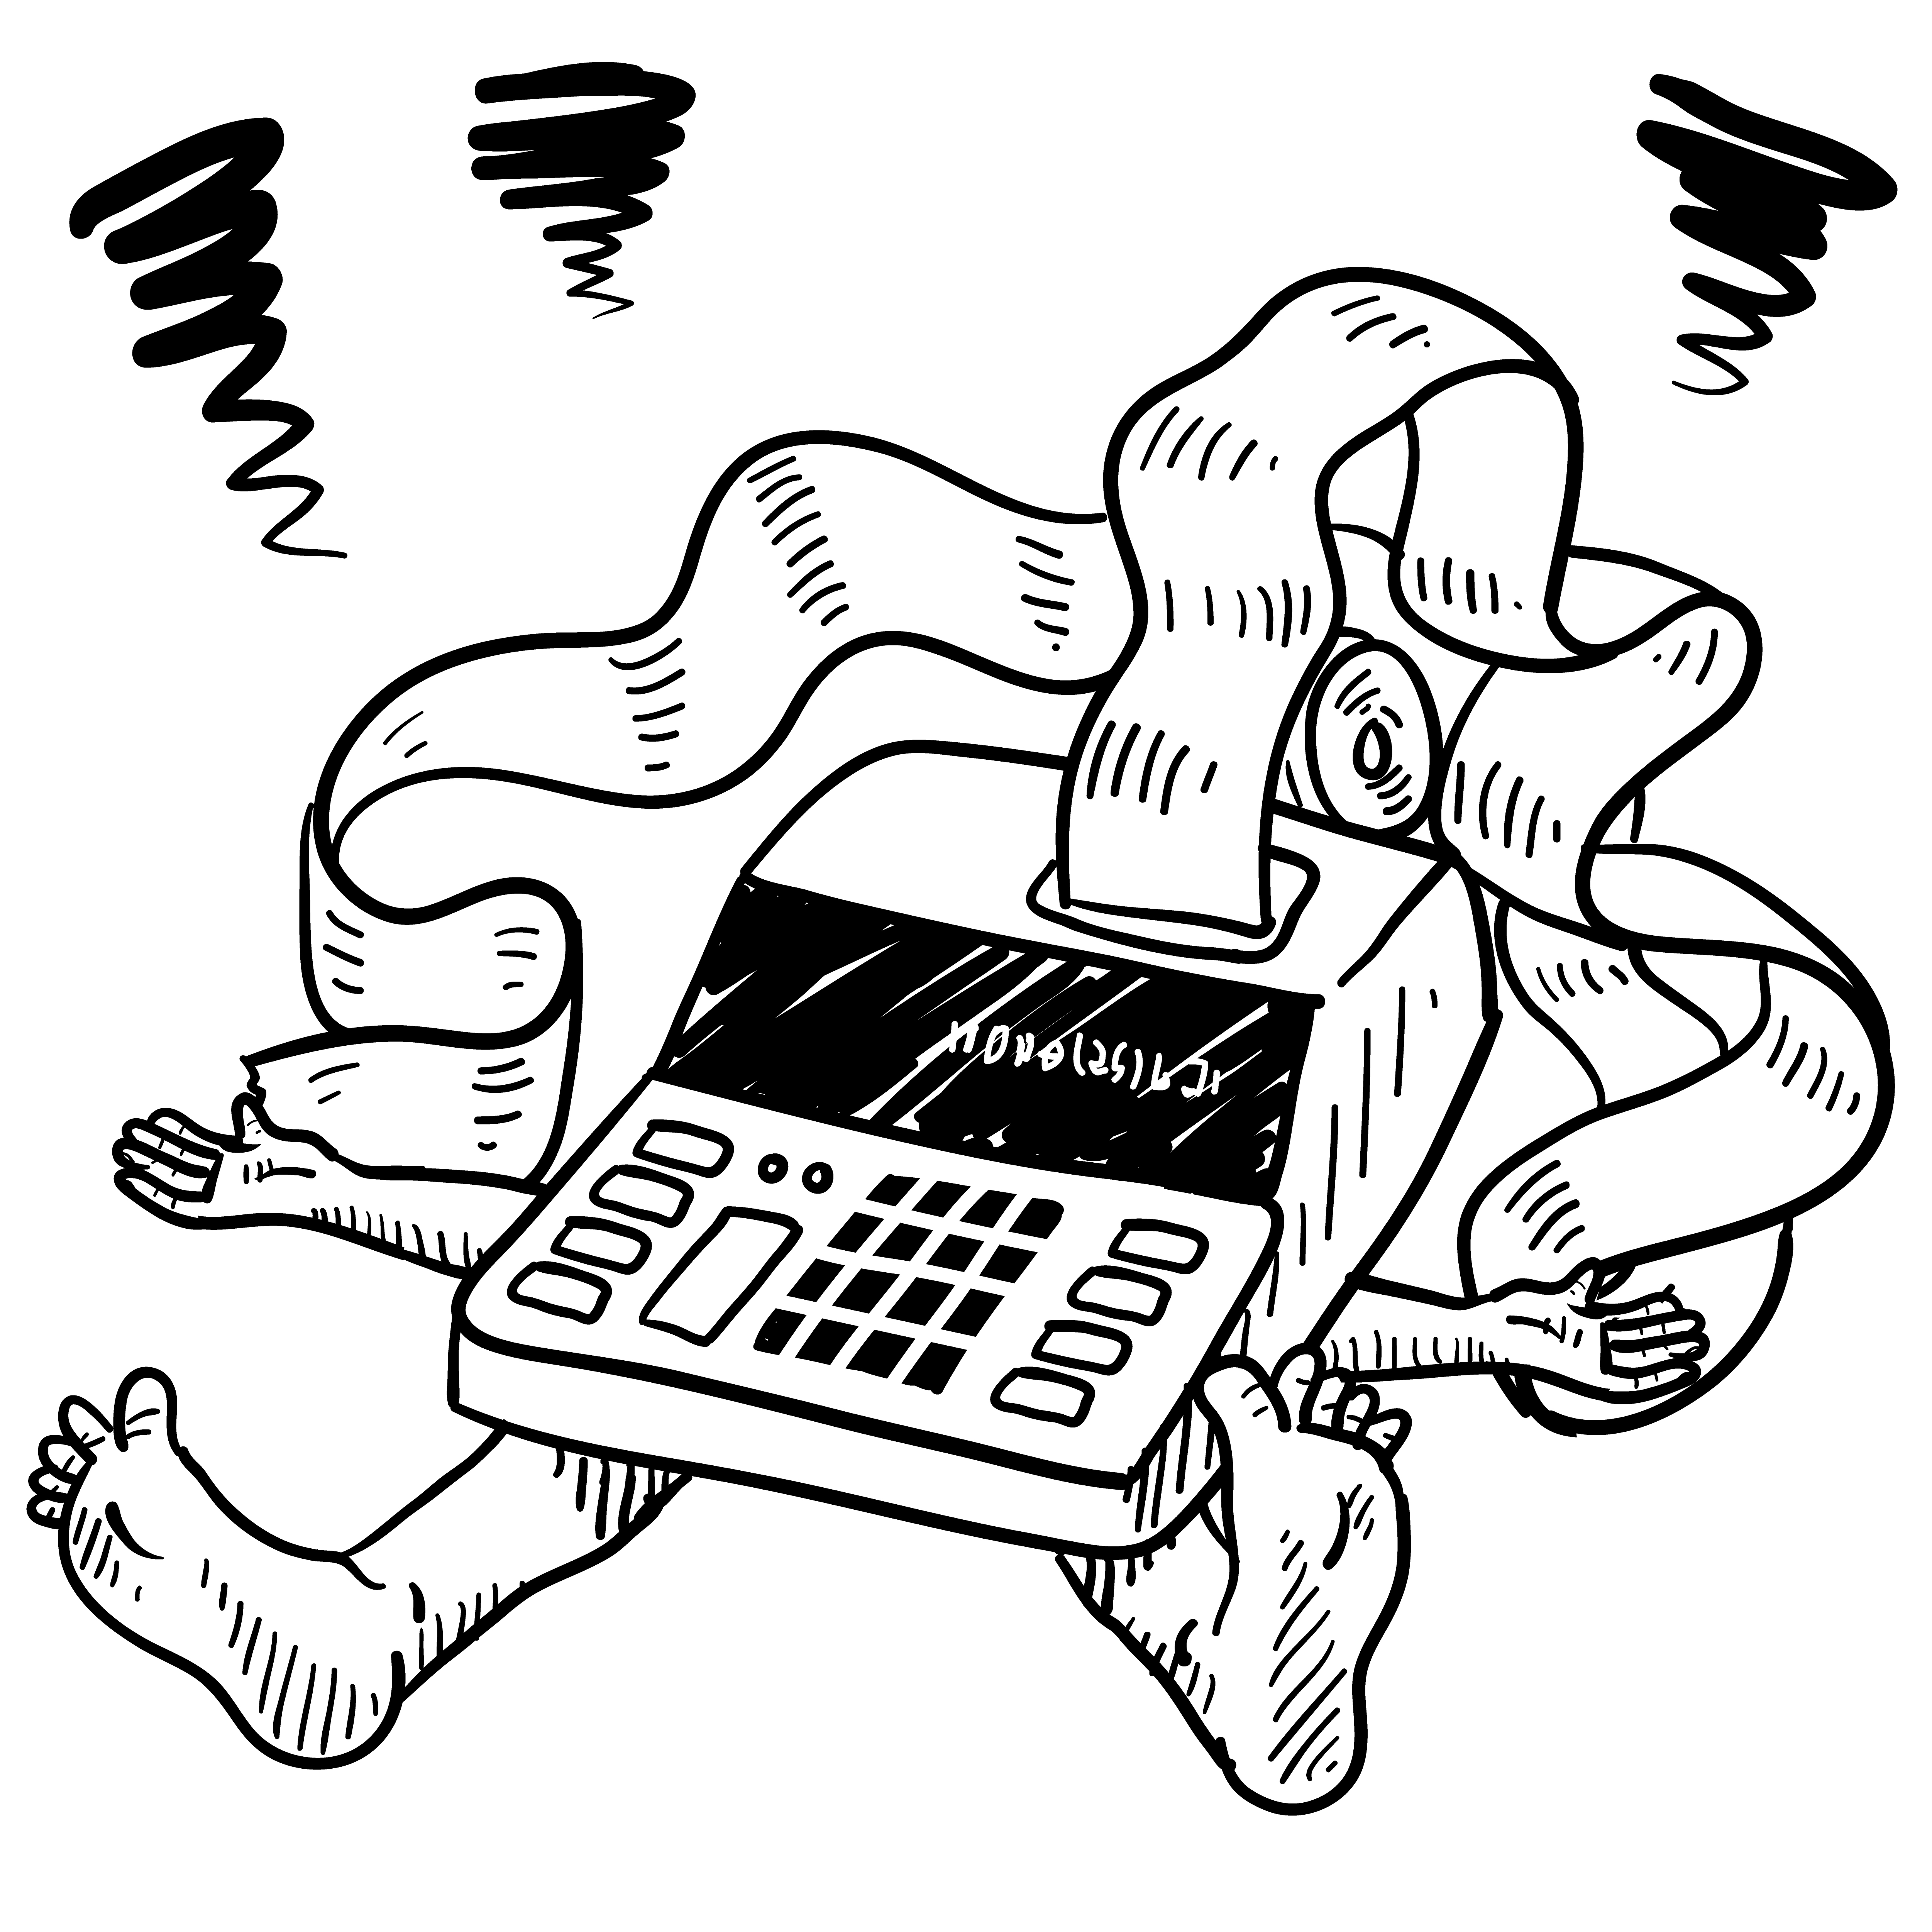
Budget killers
Unexpected expenses
Unrealistic budget line items
Lack of adjustments when necessary
Not tracking to budget
Not factoring “what if” scenarios
Notes:
Refer students to The Monthly Payment Schedule on page 10 of the Resource Guide. This is a helpful worksheet to keep track of when your expenses are due.

Slide 18
Goals
Long-term
Retire
Intermediate-term
Purchase house
Short-term
Take a summer vacation
Send kids to college
Vacation home
Get married
Purchase car
Purchase new iPhone
Notes:
Goals setting is an important piece of financial planning. Those that create goals are more likely to attain them.
Short-Term- Less than a year
Intermediate-term 1-5 years
Long-term- over 5 years
It’s not enough to just have the goal, but to be sure and figure out a plan for attaining the goal.
For example if you want to purchase a home in 6 years and want to have 20% to put down you’ll want to develop a monthly saving plan to ensure you have enough once that time comes.
You can refer students to page 7 of the Resource Guide to fill in some of their short-term goals and their plan to reach them.

Slide 19
Tracking
Monthly | Budget | Actual
Income:
Salary (after tax) | $2500 | $2750
Bank Interest | $10 | $7
Total Income | $2510 | $2757
Expenses:
Rent | $800 | $800
Food | $300 | $457
Car payment | $400 | $400
Entertainment | $200 | $190
Insurance | $150 | $150
Gas | $75 | $90
Cell phone | $60 | $60
Non budgeted |  | $325
Total Expenses | $1985 | $2472
Net Income | $525 | $285
Notes:
The best budgeting tracking tool is one you’ll actually use.
Some great tools:
Good old paper and pen
Excel or Numbers
Quickbooks or Quicken
Mint.com
Refer students to the Budget Worksheet on page 11 of the Resource Guide.
Once you develop your budget you need to make sure to keep track and compare your actuals to your budgeted amounts.
“In the example on the slide what would be some questions or suggestions you would have after reviewing the monthly budget versus actual figures?”
“Why was the actual income higher? Overtime? Raise? Should this figure be adjusted?”
“It looks like there was a lot more spent on food than was budgeted. Does there need to be an adjustment?”
“What are the non budgeted items? Should more spending categories be added?”

Slide 20
Net Worth
Assets
Liabilities
Net Worth
Notes:
Assets:
Monetary Assets
Investments
Retirement plans
Insurance policies (only if they have a cash value)
Tangible assets
Liabilities:
Any debt that has to be paid back
Current bills like electricity or phone count as a liability
Long term debts are loans like your mortgage
If liabilities > assets= negative net worth
If liabilities < assets= positive net worth
When you are young and establishing yourself it’s reasonable to expect to have a negative net worth, but as you get older it should increase.

Slide 21

Budgeting Activity
Page 12 of Resource Guide
Tony needs help developing a budget.
Notes:
Refer students to page 12 of the Resource Guide to work through the Budgeting Activity and help Tony with his budget.

Slide 22
Takeaways
Maintain a current budget
Create goals
Maintain a net income
Notes:
Wrap up the lesson by stressing some key takeaways.

Slide 23
Got it?
Do you:
  Understand the primary components of a budget and how one can be created/maintained?
  Understand the different types of income and how taxes apply?
  Understand some useful budgeting concepts such as fixed and variable expenses?
  Understand how short-term and long-term financial goals are set and utilized?
  Know some tips for keeping your budget relevant?

