Slide 1
Comparing Schools & Costs
Presented by
A Financial Beginnings Financial Education Program

Slide 2
How do you plan to choose the right school for you?
Notes:
This is an animated slide which walks through some of the silly aspects one might look for in a college.
Is it the mascot?
Or where the school is located?
Do the dorm rooms have to be nice?
Or do you want to make sure there is a great football team?

Slide 3
What are we doing today?
We will:
Research average salaries based on education and specific career aspirations.
Learn the total cost of school and the difference between sticker price and net price.
Compare total post-secondary expenses versus out-of-school annual salary and calculate the return on investment .
Notes:
Briefly review the course objectives for the lesson.

Slide 4
How much money will you make annually once you’ve settled into your career?
Notes:
“Do you know how much you will likely make in your desired career?”
“Do you think you will start at that salary?”
Based upon education and the position students plan to have, what do they feel their average annual salary will be? We are looking for average annual salary once they are established in their career, not estimated earnings right out of college.

Slide 5
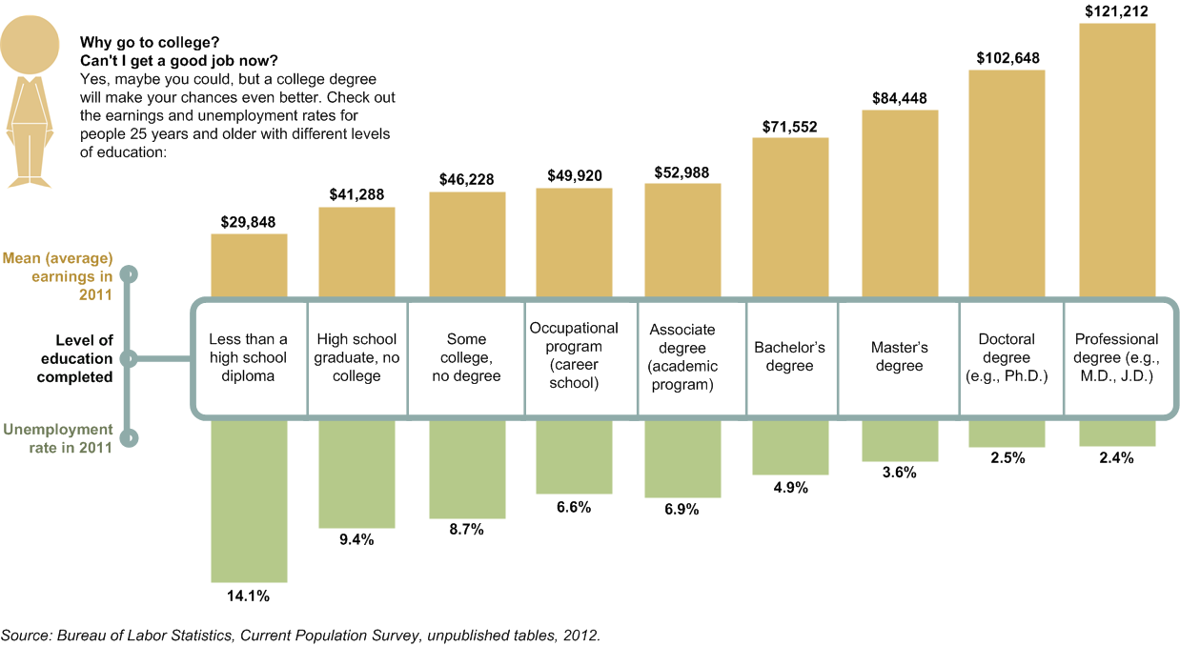
Nationally
Notes:
The numbers speak for themselves. Based upon statistics over a long period of time we know that the more educated one is, the higher one’s average annual salary and the lower one’s rate of unemployment.
“How do you think Oregon compares to the national average?”
The next slide will provide data specific to Oregon.

Slide 6
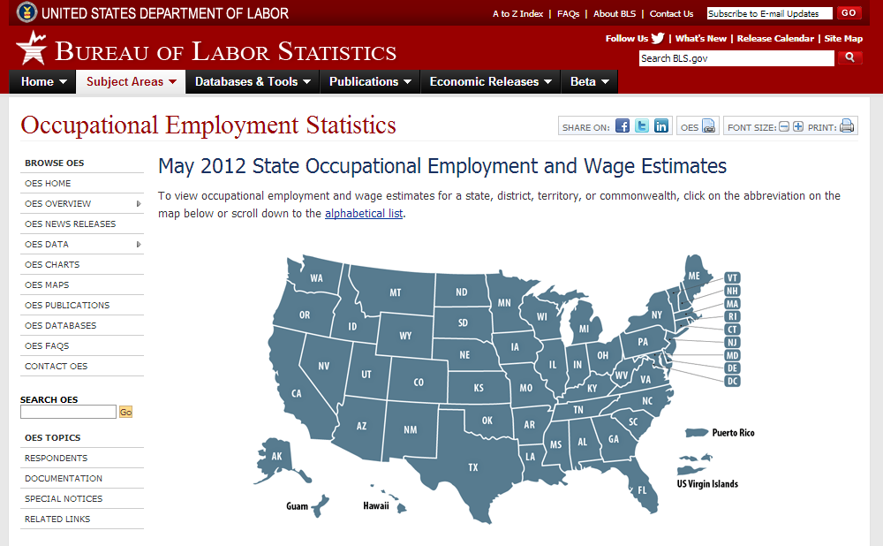
What about your specific career?
Choose the state you plan to live in.
Choose desired occupation.
Review salary averages.
Example range is for a Social Worker.
http://www.bls.gov/oes/current/oessrcst.htm
Notes:
“Have you taken the time to research the salary averages for your specific career?”
The Bureau of Labor Statistic is a great resource to not only find out salary data about your desired career, but also to provide you with industry research with a state by state breakdown.

Slide 7
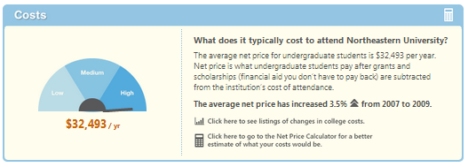
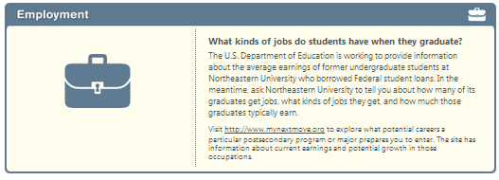
Comparison Shopping: College Scorecard
Available at collegecost.ed.gov
SOURCE: U.S. Department of Education 2013
Notes:
It is important to consider more than one school prior to enrolling. Take the time to compare key characteristics of each school such as:
Cost of attendance
Are course credits you’ll earn at one school easily transferable to other institutions?
Graduation rates
Job placement rates
Career services available to current students and graduates
The average indebtedness that most students at the school incur
A good goal for comparing schools is to maximize your school experience, and minimize the cost.

Slide 8
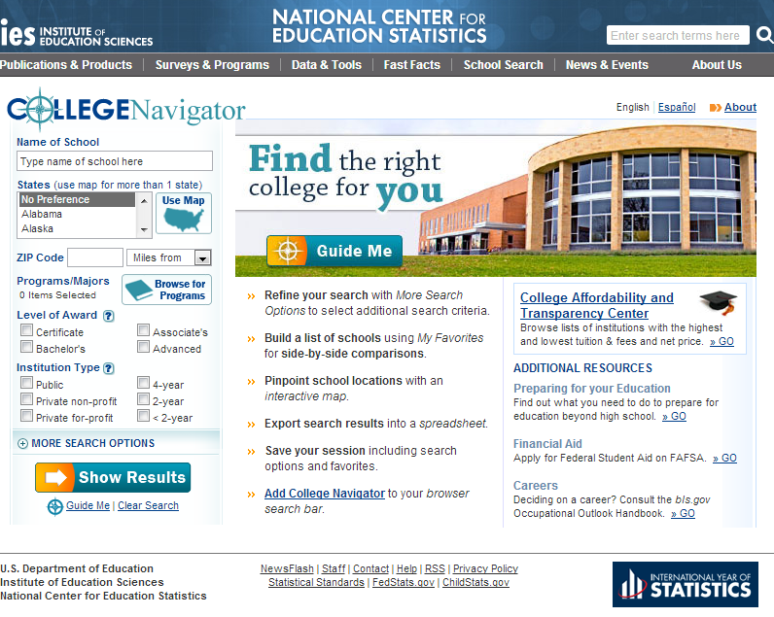
Comparison Shopping: College Navigator
Resources on this website are also available in Spanish.
Available at collegenavigator.ed.gov
SOURCE: U.S. Department of Education 2013
Notes:
The College Navigator website provides information about nearly 7,000 colleges and career schools. This site contains searchable data to assist students and their parents in the school selection process. Cost and graduation rates are important characteristics to consider, but there are many other important variables such as programs of study, number of students enrolled, and housing, just to name a few.
The website will allow you to search for schools by
Location,
Degree type and length,
Cost,
Program of study, and
Entrance requirements.
You may also combine multiple elements to refine your search.

Slide 9
Budgeting and Borrowing: Net Price Calculator
Available at collegecost.ed.gov/net-price
SOURCE: U.S. Department of Education 2013
Notes:
Net price calculators are available on school websites; and the U.S. Department of Education offers this page on its site so you can easily explore the net prices for different schools. This tool is intended to provide estimated net price information for current and prospective students and their families, based on what similar students experienced in a previous year. The calculator allows you to enter basic information about your household size and income. With this information it generates an estimate of what it will cost to attend the school after taking into account estimated grants and scholarship aid.
Don’t shy away from schools because of their “sticker price.” Instead base your decision on the net price after your financial aid is subtracted from your cost of attendance. The Net Price Calculator will help you better determine what your out-of-pocket cost will be.

Slide 10
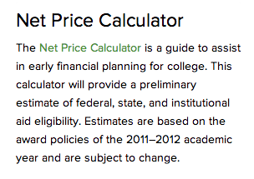
Net Price Calculator
Every college is required to offer a Net Price Calculator
More information and to find a link to each school’s Net Price Calculator
Net Price Calculator Center (ed.gov)
Notes:
You can compare the net price of all the schools you are considering before you even complete your enrollment applications.
Every school is required to provide this information so you can make the best decision about your college choice.

Slide 11
Sticker Price vs. Net Price
Sticker Price
Net Price
Notes:
If you review the tuition and fees of the University of Oregon you will find that the total cost for residents is $23,904 and nonresidents $43,875. Be aware that these costs do not factor in the grants and scholarships you could be awarded. The Net Price Calculator provides you with net price after grants and scholarships are applied.

Slide 12
Net Price Calculator Example
Parents make $50,000 annually
You are one of two children and the only one who will be in college next year
Taxable income $22,200
Tax $2,888
Notes:
The next few slides will work through comparing the net price of three universities. Here is financial data used in the example.

Slide 13
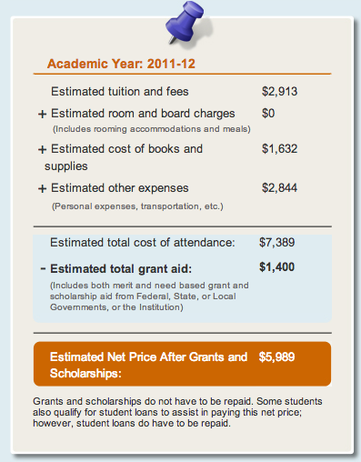
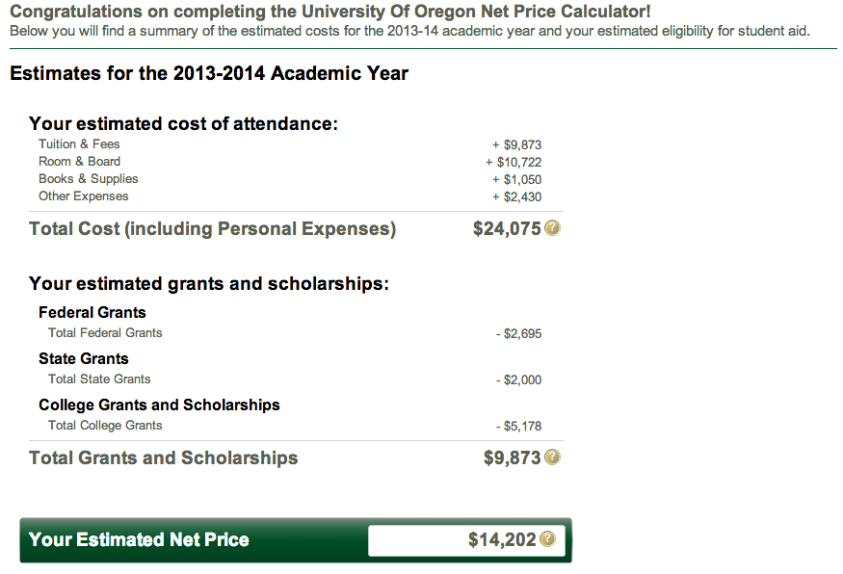
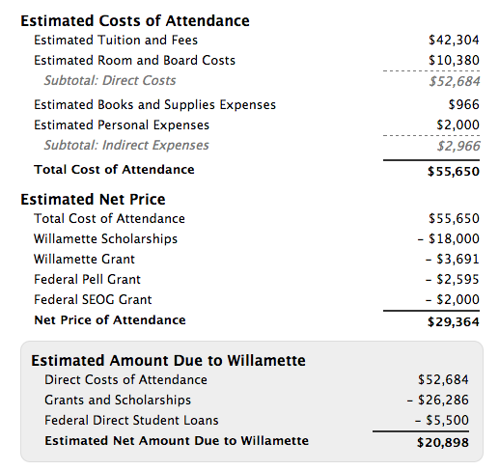
Net Price Calculator Example
Portland Community College University of Oregon Willamette University
Notes:
Based on the financial information of the example here are the estimated net prices of three different colleges in Oregon. It is important to note that Portland Community College does not provide room and board and does not factor that cost in the calculator as do University of Oregon and Willamette University do.

Slide 14
Sticker Price vs. Net Price
Sticker: $7,389 Net: $5,989 Difference: $1,400
Sticker: $24,075 Net: $14,202 Difference: $9,873
Sticker: $56,650 Net: $29,364 Difference: $27,286
Notes:
Grants and Scholarships can significantly lower the cost of attendance. In this example it is important to realize that PCC does not provide room and board.
The difference in the sticker and net price is calculated based upon the financial data of the student and their parents.

Slide 15
Calculating the Return On Investment (ROI)
University of Oregon
Net price 1 Year= $14,202
Net price 4 years=$56,808 (not including increase in tuition)
Career as a Social Worker
Starting salary= $30,840
Median salary= $54,560
Notes:
School is an investment in your future. Be sure to take into account the return (in the form of salary and other compensation) you will receive on your investment in school based upon what you’ll earn using the education. In order to do this we must think about how much total investment you will put into your education and the benefit you will receive (future earnings).

Slide 16
ROI Rule of Thumb
Total Debt
1st Year Salary
Notes:
Your first year starting salary should be greater than the total student debt you have upon leaving school. To say this another way, your total school debt should be less than your salary in your first year after graduation.

Slide 17
Back to ROI
Need for UofO $56,808
Starting Salary $30,840
$25,963 Shortfall
Notes:
Our goal is to have the total debt upon leaving school be less than our starting salary ($30,840 in our example of a social worker’s starting salary). In order to keep debt below the starting salary in this example we will need to cover a substantial shortfall of $25,963 .

Slide 18
Do you have money stashed away?
Are your parents contributing?
Notes:
You and/or your parents may already have some funds set aside for college. You will want to be sure and have a conversation with your parents about this as you are planning for school and take into account any funds you and/or your parents have set aside for school.

Slide 19
You may have to borrow
Notes:
You may have to borrow money in order to pay for school. Understand that you are leveraging this student loan debt in order to pursue your ideal career. This makes sense because you will be able to utilize future earnings to pay back the student loan debt.
Be mindful of how much debt you take on. You will have to start paying it back once you leave school.

Slide 20
How do I keep my debt low?
Keep living costs down
Live at home
Get a roommate
Become an Resident Assistant
Save on books and supplies
Look at used books online
Borrow books from the library
Share books and supplies with friends
Work
During breaks
Part-Time during school
Some employers help with tuition
Start saving now
Paid internships
Live like a poor college student
Folgers instead of Starbucks
Ramen instead of food carts
Bike or bus instead of car
Notes:
There are several options for keeping student loan debt down.

Slide 21
Options to save
-$16,426
Attend PCC first two years
-$10,000
Work during breaks and/or school
-$800
Save on books
-$2,000
1 year paid internship
Notes:
Here are some examples of how much you could save in the example.

Slide 22
Do the math
Amount needed for UofO $56,808
Work during breaks -$16,000
Be an RA one year -$10,722
Save on books -$800
Total Needed to Borrow $29,286
BINGO!
Debt is less than 1st year salary!
Notes:
Using some of the examples to lower student debt you can decrease the amount you need to borrow significantly - to less than your starting salary. It just takes some planning!

Slide 23
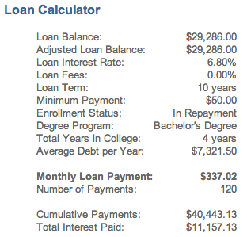
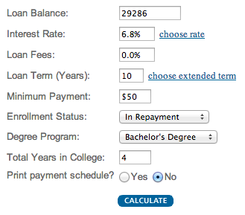
Calculate your student loan payment
Total Needed to Borrow $29,286
http://www.finaid.org/calculators/loanpayments.phtml
Notes:
We were able to cut your debt to less then your starting salary.
It just so happens that our $29,000 of student loan debt is close to the national average.
Now we need to equate the amount you would need to borrow with your post-college life. Are you ready for a payment of $337.02?

Slide 24
How does this factor into my post college budget?
Notes:
Utilizing paycheckcity.com/calculator/salary you can enter the starting annual salary of $30,840 and determine that your net pay and taxes will be 27% of total annual income.
Student loan payment of $337 = 13% of gross monthly wages
You should expect to spend about 33% of your earnings on housing (rent, utilities, etc).
Once you subtract your student loan payment, taxes and housing, that leaves only 27% for everything else. Expense you will have to cover:
Transportation
Clothing
Food
Entertainment
The list goes on and on

Slide 25
Review
Know the total cost of school before you apply
Know your future salary
Calculate ROI
Keep debt below starting salary
Calculate your student loan payment
Notes:
Takeaways from this session that you can immediately put into play to help you prepare for college.
Know the total cost of school before you apply
Research your future salary
Calculate the Return On Investment (ROI)
Keep debt below starting salary
Calculate your student loan payment

Slide 26
Got it?
Do you:
Know how to research average salaries based upon your education and specific career aspirations?
Know how to calculate the total cost of school and the difference between the sticker price and the net price?
Understand how to compare total post-secondary expenses versus out-of-school annual salary and calculate the return on investment?
Notes:
Wrap up the lesson with any remaining questions the students may have.

