Slide 1
Financing College
Presented by
A Financial Beginnings Financial Education Program

Slide 2
What different ways can you pay for college?
Savings
Grants
Loans
Scholarships
Notes:
There are several different ways to pay for college. We’ll discuss these options as well as others today.

Slide 3
What are we doing today?
We will:
Explore the different options available to pay for college
Review available college loans, various interest accumulation methods, and pay-back options
Learn the basics of the FAFSA and where to find additional support in completing your application
Learn how to compare financial aid packages
Notes:
Course objectives for this session.

Slide 4
Do you have money stashed away?
Are your parents contributing?
Notes:
You and/or your parents may already have some funds set aside for college. You will want to be sure and have a conversation with your parents about this as you are planning for school. Be sure to take into account any funds you and/or your parents have set aside for school.

Slide 5
Grants
Federal Pell Grants
Federal Supplemental Education Opportunity Grants
Teacher Education Assistance for College and Higher Education Grants
Iraq and Afghanistan Service Grants
SOURCE: U.S. Department of Education 2013
Notes:
Grants are funds you receive to pay for college that you do not have to repay. In order to find out your eligibility for grants you will have to fill out the FAFSA, which we will cover in more detail later.
Federal Pell Grants usually are awarded only to undergraduate students who have not yet earned a bachelor’s or a professional degree. The maximum Pell Grant award is $5,815 annually. The amount is determined by financial need, cost of attendance, full or part-time status and whether or not you will be attending the full academic year.
The Free Supplemental Education Opportunity Grant is administered directly by the financial aid office at each participating school and is therefore called campus-based aid. Not all schools participate. Check with your school Financial Aid office to find out if the school you are considering offers the program. You can receive between $100 and $4,000 a year, depending on need.
A Teacher Education Assistance for College and Higher Education (TEACH) Grant is different from other federal student grants because it requires you to take certain kinds of classes in order to qualify and receive the grant funds. These grants also require that you work in a certain kind of job. If you fail to meet the requirements, these grants convert to loans and have to be repaid. The TEACH Grant Program provides grants up to $4,000 a year.
Iraq and Afghanistan Service Grant has special eligibility requirements. To be eligible your parent or guardian must have been a member of the U.S. armed forces and died as a result of military service performed in Iraq or Afghanistan after the events of 9/11.

Slide 6
Scholarships Opportunities
Financial aid office
High School
U.S. Department of Labor
Federal agencies
Your state grant agency
Your library reference section
Foundations, religious or community organizations, local businesses, or civic groups
Organizations related to your field of interest
Ethnicity-based organizations
Your employer or your parents’ employers
There are bound to be several for which you qualify
Notes:
There are thousands of scholarship opportunities available. To be eligible to apply for a scholarship you may have to:
Meet certain standards in academics, talent or interest
Be part of a particular group or possibly your parents must be part of a particular group (such as where they work)
Have your education be focused in a specific field

Slide 7
Loans
Notes:
You may have to borrow money in order to pay for school. Understand that you are leveraging this student loan debt in order to pursue your ideal career. This makes sense because you will be able to utilize future earnings to pay back the student loan debt.
Be mindful of how much debt you accumulate. You will have to start paying it back once you leave school.

Slide 8
Understanding Your Loans
Direct Subsidized Loans
Direct Unsubsidized Loans
Direct PLUS Loans for Parents
Direct PLUS loans for Grad or Professional Students
Perkins Loans
Direct Consolidated Loans
Federal Student Loans
Not sure which type of loans you currently have? www.NSLDSFAP.ed.gov
SOURCE: U.S. Department of Education 2013
Notes:
A Federal Student Loan is a loan funded by the federal government to help pay for your education. A federal student loan is borrowed money you must repay with interest.
A Private Student Loan is a loan from a private lender. Examples of lenders are: a bank, credit union, state agency or school.
The William D. Ford Federal Direct Loan Program is the largest federal student loan program. Under this program, the U.S. Department of Education is your lender. There are four types of Direct Loans available:
Direct Subsidized Loans are loans made to eligible undergraduate students who demonstrate financial need to help cover the costs of higher education at a college or career school.
Direct Unsubsidized Loans are loans made to eligible undergraduate, graduate, and professional students, but in this case, the student does not have to demonstrate financial need to be eligible for the loan.
Direct PLUS Loans are loans made to graduate or professional students and parents of dependent undergraduate students to help pay for education expenses not covered by other financial aid.
Direct Consolidation Loans allow you to combine all of your eligible federal student loans into a single loan with single loan servicer.
The Federal Perkins Loan Program is a school-based loan program for undergraduates and graduate students with exceptional financial need. Under this program, the school is the lender.

Slide 9
Federal vs. Private Loans
Payments start
Interest rate
Interest while in school
Tax deductibility
Differences
Federal
Private
After leaving school
Fixed and lower
Can be while in school
Higher and may be variable
Interest accrues in school
Interest can be paid
Interest deductible
May not be deductible
SOURCE: U.S. Department of Education 2013
Notes:
It is important to exhaust the federal loans offered before seeking private student loans.
Federal Student Loans- The US Department of Education funds or insures.
You will not have to start repaying your federal student loans until you graduate, leave school, or change your enrollment status to less than half-time
The interest rate is fixed and is often lower than private loans, and much lower than some credit card interest rates
Undergraduate students with financial need will likely qualify for a subsidized loan where the government pays the interest while you are in school at least half-time.
Most federal student loans (except for PLUS loans) do not require a credit check/report. Federal student loans can help you establish a good credit record.
You won’t need a cosigner
Interest may be tax deductible
Loans can be consolidated into a Direct Consolidation Loan
If you are having trouble repaying your loan, you may be able to temporarily postpone or lower your payments (forbearance or deferment)
There are several repayment plans, including an option to tie your monthly payment to your income
There is no prepayment penalty fee
You may be eligible to have some portion of your loans forgiven if you work in public service
Free help is available at 1-800-4-FED-AID
Private Student Loans- These loans are private loans are made by a bank, credit union, state agency or school.
Many private student loans require payments while you are still in school
Can have variable interest rates, some greater than 18%
Are not subsidized so interest accrues while in school
May require an established credit record and the cost will depend on your credit score
You may need a cosigner
Interest may not be tax deductible
Cannot be consolidated into a Direct Consolidation Loan
May not offer forbearance or deferment options
It is unlikely the lender will offer loan forgiveness

Slide 10
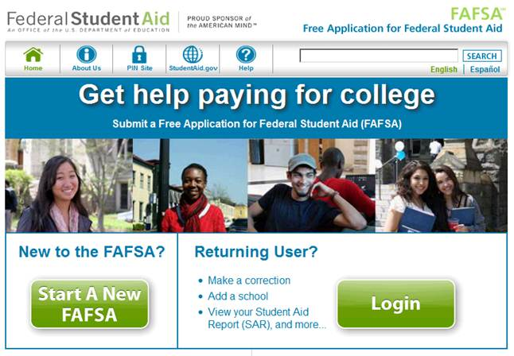
Apply for Aid: FAFSA
Resources on this website are also available in Spanish.
Takes less than 30 minutes to complete online at studentaid.gov
Real-time help is available via online chat or by phone at 1-800-4-FED-AID
IRS Data Retrieval Tool pre-populates tax information
Determines family’s ability to contribute to cost of attendance
SOURCE: U.S. Department of Education 2013
Notes:
The Department of Education Office of Federal Student Aid provides financial aid. Completing the Free Application for Federal Student Aid, or FAFSA, is the first step in applying for federal grants, loans, and work-study. Remember, the first F in “FAFSA” stands for “FREE”—there’s no need to pay anyone to help you complete the FAFSA. Look for free FAFSA completion workshops offered by area high schools, colleges and community organizations to get help completing your FAFSA.
Real-time help to complete your FAFSA is available on the FAFSA site as you fill out the application. You can chat live with a customer service representative in a secure chat session. You also can get help by phone at 1-800-4FED-AID .
Don’t assume that you aren’t eligible to receive federal student aid! The FAFSA provides access to the largest source of college funding, and your school and your state’s higher education agency also will use it to determine your eligibility for their financial aid.

Slide 11
You will need
Your Federal Student Aid PIN
Your Social Security number
Your driver’s license number
Your tax records
Records of untaxed income
Records of all of your assets
List of the school(s) you are interested in attending
SOURCE: U.S. Department of Education 2013
Notes:
If you are a dependent student then you will need this information for your parents also.
Your Federal Student Aid PIN- In order to sign your FAFSA electronically, you’ll need a Federal Student Aid PIN. You can help to prevent processing delays by getting a PIN before you begin the FAFSA.
Your Social Security number- If you are not a U.S. citizen, you’ll also need your Alien Registration Number.
Your driver’s license number- If you don’t have a driver’s license, then don’t worry about this step.
Your tax records- Use income records for the prior tax year. There is the ability to automatically fill in tax information from the IRS.
Records of your untaxed income- This includes a whole bunch of variables that may or may not apply to you, like child support received, interest income and veterans non-education benefits.
Records of all of your assets (money)- This includes savings and checking account balances, as well as investments like stocks and bonds and real estate.
List of the school(s) you are interested in attending- The schools you list on your FAFSA will automatically receive your FAFSA results electronically. They will use your FAFSA information to determine the types and amounts of financial aid you may receive. You can list up to 10 schools where you will apply or attend.

Slide 12
After filing
Look out for your Student Aid Report (SAR)
Locate your Expected Family Contribution (EFC)
Make corrections if needed
Review your financial aid history information
Double-check with your schools
SOURCE: U.S. Department of Education 2013
Notes:
Look out for your SAR- Your SAR is a paper or electronic document that gives you basic information about your eligibility for federal student aid. This document also provides the answers you gave to the questions on your FAFSA.
Locate you EFC- Your EFC can be found in the box at the top of the first page of your SAR, under Social Security Number. Your EFC is a measure of your family’s financial strength and is calculated according to a formula established by law. This formula considers your family’s taxed and untaxed income, assets, and benefits as well as your family size and the number of family members who will attend college during the year.
Make corrections if you need to- If you filed your FAFSA before filing your tax return then you will need to update the estimated numbers with the actuals shown on your tax filing.
Review your financial aid history information- The last page of your SAR includes information about your financial aid history, specifically the loans you have taken out. It can be complicated and confusing to keep track of all your loans and interest rates, but it is very important. Reviewing the financial aid history in your SAR will help you be aware of how much you are borrowing and how much you will owe – and repay – after leaving school.
Double-check with your schools- Make sure that you double-check with the financial aid offices at the school you applied to. Sometimes schools need additional paperwork or have additional deadlines.

Slide 13
Wait for the offers
Notes:
When you fill out the FAFSA you will be asked to which schools you will be applying. Upon acceptance to a school you will receive a financial aid package which will outline the grants you are eligible for, the loans available to you, and any other funding options, such as an on-campus job.
The next slide outlines a great tool to utilize to compare the financial aid offers.

Slide 14
Comparison Shopping: Financial Aid Shopping Sheet
More info on Financial Aid Shopping Sheet: www.consumerfinance.gov/students/knowbeforeyouowe/ ‎
SOURCE: U.S. Department of Education 2013
Notes:
The Financial Aid Shopping Sheet is a standardized financial aid award letter that helps students better understand the amount and types of financial aid they qualify to receive at each school. You may or may not receive this from a school that offers you aid. The Shopping Sheet lays out the total cost of attendance including tuition, fees, and other expenses. The form also breaks out each type of aid a student may be eligible to receive at that school:
Grants and scholarships
Work-study
Loans
Additionally, the Financial Aid Shopping Sheet provides information on the median amount of total loan indebtedness for students attending a particular school. This can help you estimate the amount of debt you may have after graduation.
The Financial Aid Shopping sheet is not mandatory, although many schools provide it, and others are in the process of adopting it.
The Consumer Financial Protection Bureau has an online tool to allow you to input information from a financial aid award to compare awards from various schools.

Slide 15
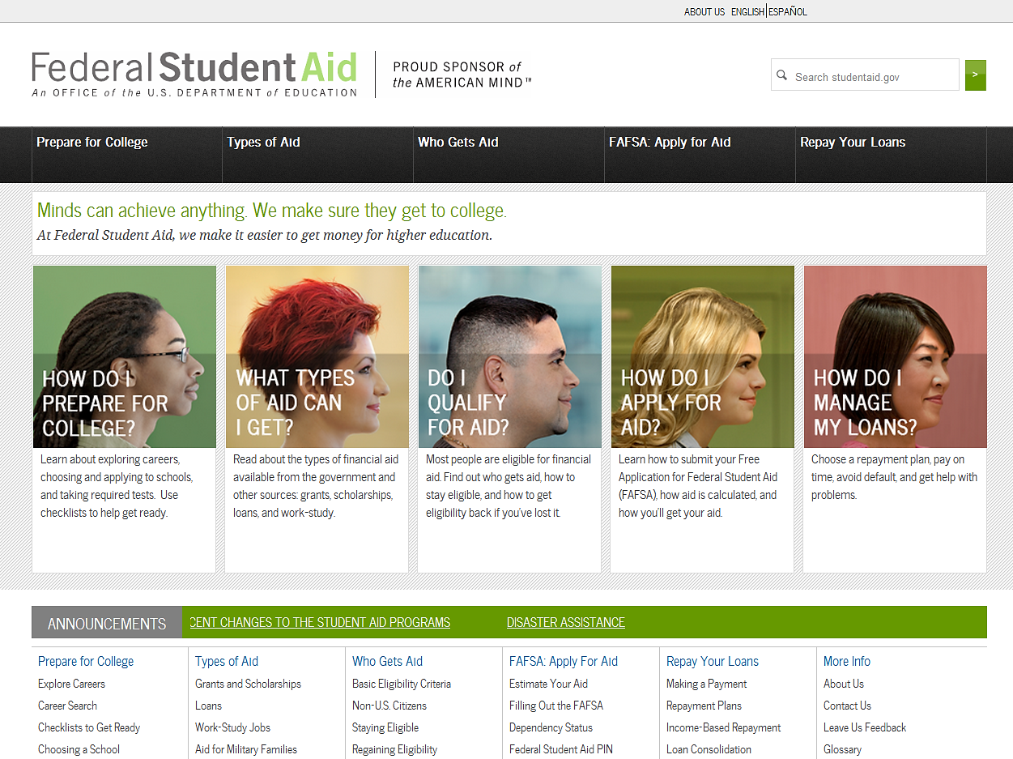
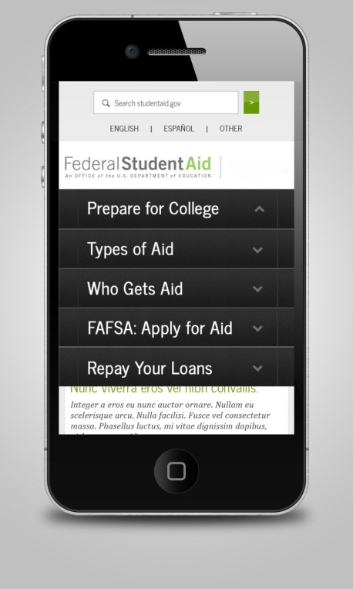
Stay Informed: StudentAid.gov
SOURCE: U.S. Department of Education 2013
Notes:
At StudentAid.gov, get ready for college or career school, learn about federal student aid and how to apply using the FAFSA, and get information on repaying student loans. The site offers tools to assist you in searching for colleges, applying for aid, and managing loan repayment.

Slide 16
Get started now
Research & Apply for Scholarships
Complete FAFSA in October
Compare Awards
Understand Loans
Notes:
Research and apply to scholarships
Apply for aid via the FAFSA: Starting October 1
Compare financial aid awards
Understand your loans before accepting them:
You should never take out debt without first having a plan for repayment.
Be sure to calculate your estimated post college student loan payment before taking out a loan.

Slide 17
Got it?
Do you:
Understand the different options available to pay for college?
Understand college loans and how interest accumulation and repayment options vary?
Know the basics of the FAFSA and where to find additional support in completing an application?
Know how to compare financial aid packages?
Notes:
Course objectives for this session.

