Slide 1
Career & Education Path
Presented by
A Financial Beginnings Financial Education Program

Slide 2
What did you want to be in….?
Elementary School Middle School Now
Notes:
Ask students “What did you want your career to be when you were in elementary school? Middle school? And how about now?”
Ask students “Have any of you had the same career aspirations since you were young?” Chances are they have changed their minds as they grew older.
Whether you know exactly what you want to do, have no clue or are somewhere in between, this lesson will provide you with some direction.

Slide 3
What are we doing today?
We will:
Identify skill sets and interests that further career objectives
Explore the multiple positions available within a desired career; review salary ranges
Determine education requirements necessary for desired position
Research schools that specialize in programs that advance career objectives; consider if prestige comes into play
Understand the favor given to a well-rounded job candidate (the importance of extracurricular activities, volunteerism, etc.)
Notes:
Briefly review the course objectives for the lesson.

Slide 4
Where do you fit in determining what you’ll be when you grow up?
Have no idea
Have an idea of the industry or your major
Know the exact job you will have
Notes:
Students will be somewhere along a spectrum from the end where they have no idea what they want to do, to the other extreme where they are very clear about what they want to do.
Let students know that anywhere they are on this spectrum is fine. This lesson will provide some direction and help to clarify their thinking as they pursue their career.

Slide 5
I know exactly what I want my career to be!
Notes:
Ask students:
“How many of you know what your ideal career is? Or have an idea of an industry in which you want to work?”
“What is your ideal career?”
“How did you decide this career was the best for you?”

Slide 6
Things May Change
Make sure you are preparing for possible career changes.
Notes:
According the the Bureau of Labor and Statistics the average person will hold 11 jobs from age 18-46.
It’s hard to track how many careers an individual has in their lifetime, but you likely know several people (possibly yourself) who have had multiple careers. People will probably change jobs within an industry and also change industries as they move from job to job.

Slide 7
I have no idea what I want to do!
Notes:
Ask students:
“How many of you have no idea what you want to do as a career? It is just fine not knowing what you want to do.”
“How many of you have an idea of the field or industry you wish to enter?”

Slide 8
Understanding YOU
Notes:
Personal preferences- Is there a specific geographic location or company where you would like to work? Do you know the work schedule you would like to have? Consider this - Are you a 9am-5pm type, a night owl, a morning person?
Skills & abilities- Explore the things you are good at – where you have interest or talent. Would these skills be beneficial for a specific career? Don’t worry if you discover that you lack the skills needed for your career. You can always work to develop them.
Interests- High school provides an opportunity to do a lot of exploring. Are there courses that interest you? What other interests do you have outside of school?
External factors- You have to take into account factors such as the economy or the job market. Is there a demand for the job you want to pursue? Is the job located in a particular place?
Achievements- In what personal achievements do you take the most pride? What are the items that you will want to emphasize on your resume or college application?
Motivations & values- What is most important to you? What are your core values? What drives you? These are important questions because your chosen career may not align with your core values.
Personality- How do you get along with others? What types of personalities do you enjoy most? Have you taken a personality assessment, like Meyers-Briggs Type Indicator?
Knowledge- What subjects do you find easiest to understand? Are there areas where you feel you have a strong foundation of knowledge?

Slide 9
Tools to help
Career Assessments
Job Shadowing
Networking
Volunteering
Career Counseling
Internships
Notes:
There are several ways to explore your interests and determine your career path. Not only do these elements help you to choose a career, they may provide you with experience to include on your college application or resume.
Career Assessment- “Have you taken a career assessment before?” “Did you feel the career aligned with your personality and preferences?” “Were any of you surprised by the results?”
Job Shadowing- Some jobs are not all they appear to be. Spending time shadowing someone in the field you wish to enter is an important step in better understanding what the job entails. The more people you shadow the better understanding you will have of the career so you can determine if it is right for you.
Network- It is never too early to begin building your professional network. Connecting with people can put you in touch with hiring managers. Start collecting business cards, set up a LinkedIn account, join some clubs.
Internships and/or Volunteering- These are great ways to develop higher level skills and gain experience, and you can include them on your resume.
Career Counseling- There are an infinite career possibilities. Career counseling can help you pull together all the aspects that make up “you” and suggest careers you may not have considered. What if there is need for the position you would like, but the positions are not frequently available? Or perhaps the position doesn’t exist? Sounds like you might be an entrepreneur.

Slide 10
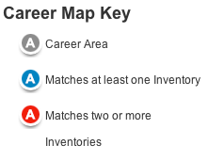
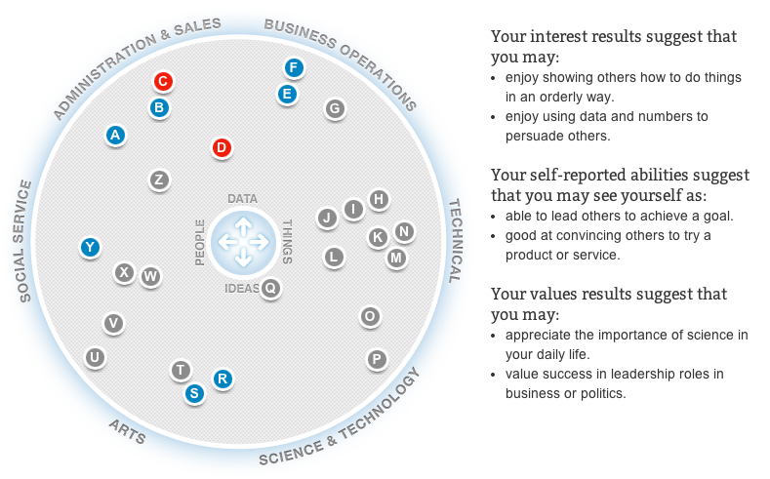
ACTProfile.org
Notes:
www.ACTProfile.org is a great resource to explore career, positions, and school majors.
It is well worth the few minutes it takes to do a couple of career assessments. The program will take your answers from the assessment and create a career map that outlines career suggestions.
From this map you can click on the letters to explore positions within the suggested areas.

Slide 11
Determining your education path
School has been “your job”
Shift in mindset
Increased options
Matching education to desired career
Trade School/Associate Degree
Bachelor’s Degree
Master or Law Degree
Doctorate
A Pediatrician is going to have to go to medical school
An Electrician will need to go to a trade school
Notes:
Up to this point students have viewed school as “their job.”
Once students are enrolled in post secondary education their focus should shift to viewing education as a tool to achieve their desired profession. School becomes a means to an end – their career.
The options for choosing post secondary education are infinite and decisions about those choices can be difficult to make.
Students will need to have a strong idea of what they want to do as a profession in order to determine the right education path.

Slide 12
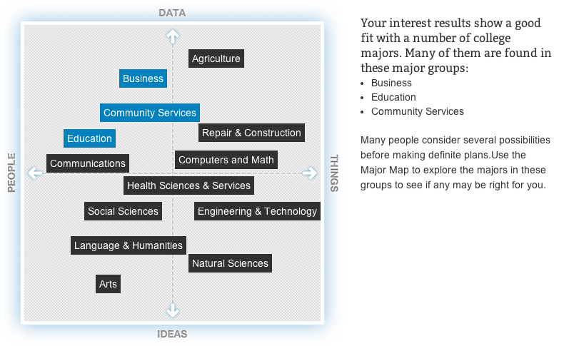
ACTProfile.org
Notes:
Based on the career areas identified by the assessments on the career map, the program offers information on education majors and possible degrees you could pursue.
Even though you may show a preference for a specific area, don’t feel like you have to focus all of your studies in one area. Taking courses outside of your major will help you to have a broader knowledge base.
Understand that as you start to work through your coursework a little variety may reveal that you want to change your career and/or major.
The example above shows that Business, Community Service and Education align with this individual’s interests. If you click on “Community Service” a bar will pop up showing the degree options for this area.

Slide 13
Your career is just one piece of your future self.
Timeline Activity
Notes:
Hand out the Timeline Activity to students. Allow them some time to choose the milestones they wish to achieve and at what age in their life they expect to reach it. When they have finished this, ask them to flip the page over and fill in the milestones by decade.
Lead students through a discussion on what they found. Usually we find that when we are in our 20s and 30s we have the most happening in our lives (getting married, having children, buying a house), but it’s also the point in our life when we are making the least amount of money.

Slide 14
Life’s balancing act
Leisure
Career
Family
Finance
Notes:
“Do you work to live or live to work?” Some view work as a necessity to make money to support their lives. Others absolutely love their jobs and could not imagine life without working.
Ensuring a proper balance in your personal and professional life is imperative to live a successful life.
“Do you want to get married? Or stay single?”
“Will you want a big family? Or just one child?”
“How much leisure time do you want? Do you want time for your hobbies or travel?”
“Do you want a job that you can throw yourself into?”
“Do you want to make a lot of money? Or is money a lower priority on your list of life goals?”

Slide 15
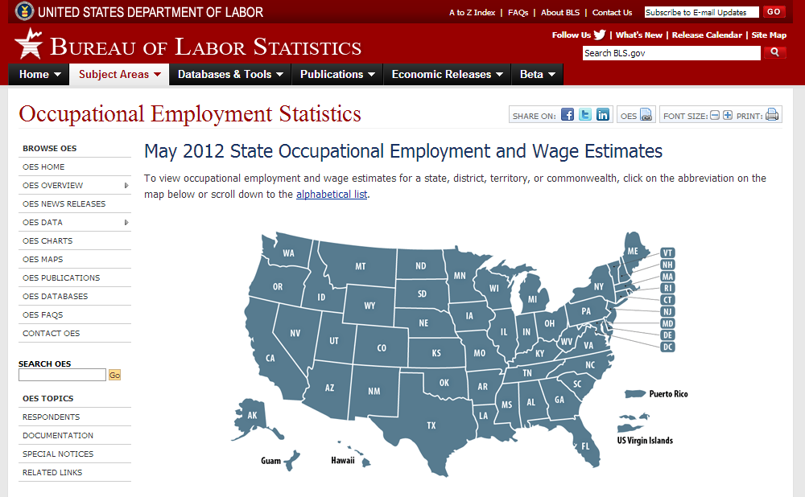
Will my career provide the lifestyle I want?
Choose the state you plan to live in.
Choose desired occupation.
Review salary averages.
Example range is for a Social Worker.
http://www.bls.gov/oes/current/oessrcst.htm
Notes:
It is important to make sure that the career we want is also going to provide the lifestyle we envision.
The example above shows the marketplace wages for a social worker in Oregon.
When entering into a field we must expect that we are going to begin our career at the bottom of the pay scale. As our experience and skills increase our salary should increase to reflect our increased value to the organization.
Though $30,000 or $40,000 may seem like a lot now, it is not going to provide for a high-end lifestyle. Living expenses quickly eat up our salaries.
In addition to employment statistics, the Bureau of Labor and Statistics also provides great information about the demand for the field or career you may consider. The more in-demand the position, the easier it is to find a job.

Slide 16
The importance of doing your research on salaries
Ensure the salary meets your expectations
Helps you to determine the Return On Investment (ROI) for your education
Allows you to get an idea of what your starting salary may be
Notes:
You will want to ensure that you understand the level of salary your desired position offers in the marketplace and determine if it will meet your expectations. It is important to have a realistic view of how much your desired lifestyle is going to require in terms of earnings and compensation. Other factors also impact your living expenses. Consider this: Will you be married? Will you have children? Will you have student loans to pay?
Education is an investment in your future earning potential. The cost of education can vary significantly and you want to be certain that you are not investing more in your education than necessary.

Slide 17
Starting at the ground floor
Law Clerk
Paralegal
Attorney
Partner
Judge
Notes:
It’s important to understand that you are likely not to start your first job after school in your ideal career. You may also find that once you are working in the field, you are not satisfied and want to make a job or career change.
One aspect of careers that is important to understand is the level of growth opportunity within the industry. The example above shows the growth opportunities for someone interest in pursuing a career in law.
For example, you may want to be an attorney. You will likely need to work your way up and gain experience in lower level positions before you are ready for higher level positions. After you have experience as an attorney, you may find you are interested in becoming a partner in your firm or even consider the possibility of becoming a judge.

Slide 18
What school?
Career determined
Positions explored
Educational requirements determined
Now: Choosing the right school.
Notes:
You’ve been introduced to some tools to help determine your possible career and the salary it will likely pay.
You’ve explored the different positions in the field and the career ladder in that field.
You understand the education you need in order to enter the field.
Now you have to determine the right school to attend.

Slide 19
Determining the right school
Does school prestige matter for your desired career?
What schools have a strong programs in your desired field?
How far away do you want to go to attend school?
Notes:
Does school prestige matter? It’s important to consider the impact of attending a highly prestigious school will have on your career. For some careers a prestigious school has a low impact, but for others a well-known school can provide a boost to your career.
What schools have strong programs in your field? Most schools offer degrees in a wide variety of subject areas. Even so, it’s important to understand that many schools specialize in a particular field. You have to weigh how the marketplace values your desired position. Will you be viewed more positively if you have gone to a school that specializes in your field and has a strong reputation? For many professions it does not matter, but for some it matters a great deal. The medical and legal professions often place a higher value on a graduate from a prestigious school.
How far away do you want to go to attend school? College can be an opportunity to “fly from the nest” and have some time for personal discovery. Even if you know you want to live in the same geographic area after graduation, you may want to consider attending a school farther away from home just for the experience. If saving on living expenses while attending school has a higher priority, then you may elect to attend a school closer to home.

Slide 20
Where do I go from here?
Explore career options
Research salaries
Keep in mind your life plan
Determine education path
Research schools
Notes:
Now it’s time to consider next steps:
Explore career options
Research salaries
Keep in mind your life plan
Determine education path
Research schools

Slide 21
But it doesn’t stop here
You will:
Want to narrow down your list of schools where you apply
Begin applying to the schools that you determine to be the best fit
Likely want to apply for financial aide
Once accepted, compare financial packages
Notes:
This is just the beginning of the process of choosing your career and education path. Here are some final considerations and steps you can take right now.

Slide 22
Got it?
Do you:
Know how to identify skill sets and interest that further career objectives?
Understand how to explore the multiple positions available within a desired career; review salary ranges?
Know how to determine the education requirements necessary for your desired position?
Know how to research schools that specialize in programs that further career objectives; consider if prestige comes into play?
Understand the favor given to a well-rounded job candidate (the importance of extracurricular activities, volunteerism, etc.)?
Notes:
Review the session objectives with students and answer any remaining questions they may have.

