Slide 1

Welcome
COUNTRY Financial® proudly provides financial literacy education to your classroom.
Financial literacy is important, no matter how old you are and
no matter your goals. Understanding money allows you to make
more informed choices and to be better able to pursue your
dreams. Congratulations on taking this first step in becoming
more financially savvy.
Sponsored by

Slide 2
Financial Foundations
Risk Management
A Financial Beginnings Financial Education Program
©
2015 Financial Beginnings
Notes:
Take the time to introduce yourself including who you work for and details of your job. If you are not working then share with them why you are passionate about teaching them about insurance.

Slide 3
Match the star with the body part and insured amount
Famous Person | Body Part | Amount Insured
America Ferrara | Legs | $27,000,000
Gene Simmons | Taste Buds | $1,000,000
David Beckham | Voice | $10,000,000
Troy Polamalu | Smile | $1,600,000
Bruce Springsteen | Teeth | $30,000,000
Angela Mount | Hair | $195,000,000
Julia Roberts | Whole Body | $31,200,000
Daniel Craig | Tongue | $9,500,000
Jennifer Lopez | Behind | $1,000,000
Notes:
Refer students to page 4 of the Resource Guide and allow them a few moments to match the famous person, with the body part they insurance, and the amount they insure it for.
The next slide provides the answers.

Slide 4
Answers
Famous Person | Body Part | Amount Insured
America Ferrara | Teeth | $10,000,000
Gene Simmons | Tongue | $1,000,000
David Beckham | Legs | $195,000,000
Troy Polamalu | Hair | $1,000,000
Bruce Springsteen | Voice | $31,200,000
Angela Mount | Taste Buds | $16,000,000
Julia Roberts | Smile | $30,000,000
Daniel Craig | Whole Body | $9,500,000
Jennifer Lopez | Behind | $27,000,000
Notes:
Answers to page 4 of the Resource Guide.

Slide 5
But we’re not stars!
Don’t worry there are other policies you might interested in like….
Kidnapping Insurance
Chicken Insurance
Fantasy Football Insurance
Cold Feet Insurance
Bed Bug Insurance
Multiple Birth Insurance
Notes:
Kidnapping Insurance- Think there would be a high ransom on your head? This insurance can help to cover that.
Fantasy Football Insurance- You can purchase this insurance to protect you if one of your hot picks is injured and throws off your game.
Bed Bug Insurance- Get back from a hotel to find that you have brought home bed bugs. It can cost a lot to rid your home of these bugs.
Chicken Insurance- Just like your policy covering the naughty behaviors of dogs you can also get insurance to cover the naughty behaviors of chickens, which have become all the rage as pets.
Cold Feet Insurance- Can you imagine if you spent thousands on a wedding and your fiancé got cold feet?
Multiple Birth Insurance- Kids cost about $200,000 each by the time they reach 18, can you image having 3 when you only planned on one?
“Where would someone get these crazy types of insurance?” Lloyd’s of London has helped consumers for years to insurance their interesting risks.

Slide 6
Why are we here today?
We will:
  Understand what insurance is, why you need it and how it works.
  Learn what insurance premiums are and how they are determined.
  Know what liability coverage is and how it applies to auto and renters/homeowners insurance policies.
  Be able to explain types of insurance and when they apply to real life.
  Understand insurance contracts and the major decisions that have to be made when purchasing policies.
Notes:
These are the course objectives for Risk Management.

Slide 7
How do we manage risk?
What is risk?
Notes:
Risk is the exposure to injury or loss.
“Can you give examples of risks that you face every day?”
“How do you manage those risks?”

Slide 8

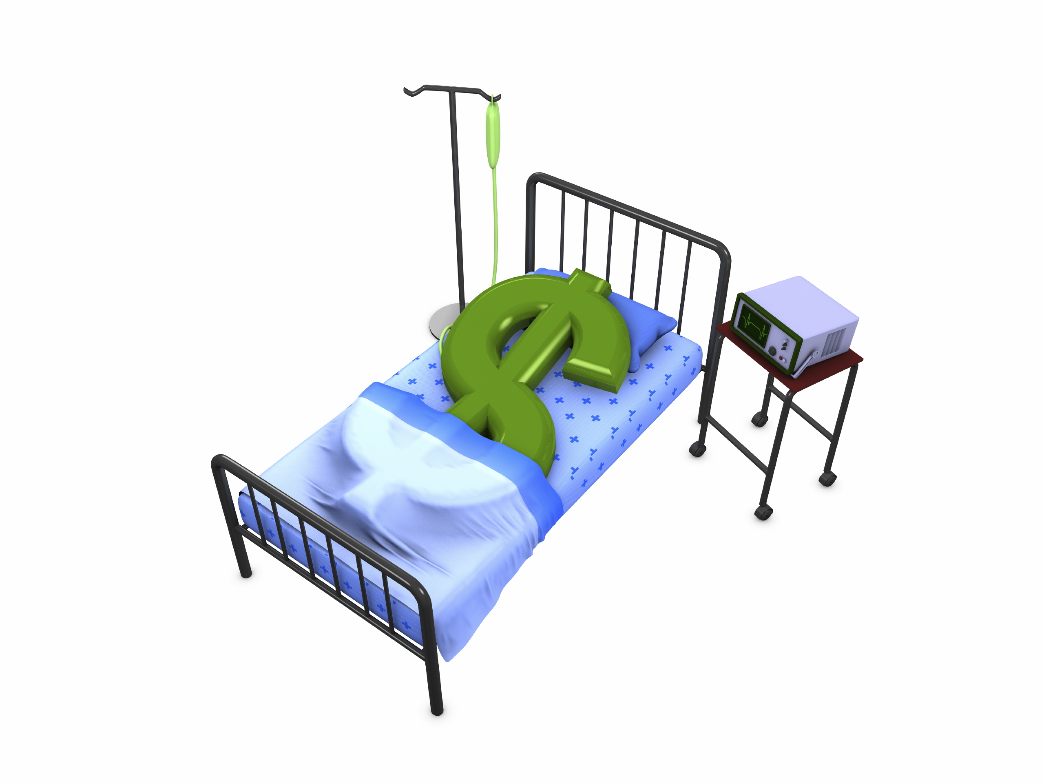
Calculating possible loss
Do I get collision coverage on my car?
Worst case- Value of the car
Do I get health insurance?
Worst case- Can’t determine amount
Notes:
We know that we face a multitude of risks in our everyday lives. In order to help us determine the insurance we need we have to take into account the possible loss exposure.
For example if you have a car that is paid off, you can decide if you want collision coverage on it. If you total the car the most that you would be out is the value of the car. You can put a dollar figure on the potential loss and decide if you are willing to assume the risk.
Health insurance is one of the most expensive coverages to maintain, but part of the reason for that is the potential for loss is so great. If you end up getting really ill and needing a lot of medical attention, there could be no end to the amount of medical bills.

Slide 9
But how likely is it?
That you’ll die in a
  Car accident 1 in 84
  Plane crash 1 in 5,051
  Shark attack 1 in 60,453
  Train crash 1 in 156,169
Notes:
Here are some statistics on the likelihood of death. Though our emotions may be more inclined to be scared of being eaten by a shark or getting into a plane crash, the statistics are heavily weighted towards every day risks.

Slide 10
Weighing the risk
Insurance
Premium
Piece of mind
Risk
Maximum exposure
Likelihood of loss
Your acceptance
Notes:
With our facing risk every day, we have to weigh the amount of risk we face so we can best determine how to manage it.
Insurance can be a tool to help us manage the financial loss associated with loss.
Things to ask yourself:
How much would I lose financially?
How much would it cost to insure against this loss?
What is the likelihood of loss?
Am I willing to accept the risk?
Will it provide me piece of mind to have this coverage?

Slide 11
Common types of insurance
Auto
Health
Life
Disability
Homeowners
Renters
Notes:
Automobile Insurance- provides coverage for auto accidents or damage to your vehicle in case of theft, collision or break-in.
Homeowners/Renters Insurance- provides coverage for losses due to damage or destruction of your home or rental.
Health Insurance- pays for medical treatment if you are injured or sick.
Life Insurance- provides coverage after death and is often paid to a family member.
Disability Insurance- provides monthly income when one becomes disabled.

Slide 12
Some of the basics
Risk Pooling
Insurance Policy
Premium
Liability
Pooling money together incase of loss
Contract between you and the insurance company
The amount you pay for insurance
Coverage to protect others for damage you cause to them
Notes:
Walk students through some of the basic terms relating to insurance.

Slide 13
Auto Insurance
How many of you drive?
Do you pay for your own insurance?
Are you willing to share how much?
Notes:
You will find the majority of participants are already driving. Some pay for their own insurance. They usually are happy to share how much they pay for insurance and it can be very surprising the range of insurance premiums.

Slide 14
Why do we need auto insurance?
Notes:
This question will get the students started and the next two slides can delve into the question further. You can direct students to page 5 of the Resource Guide to list some of their answers.

Slide 15
Even a minor accident can add up to a lot
Your car
Other car(s)
Medical bills
Lost wages
Pain and suffering
Prosecution
Legal fees & fines
Notes:
Damage to your car - Even a minor scratch can cost hundreds of dollars to repair. Collision coverage can cover repair costs to your car.
Damage to other cars involved - What if multiple cars are involved? What if you cause damage to a really expensive car? The dollars can add up quickly. Your liability coverage will pay for damage you cause to others’ property.
Medical bills - The cost of healthcare is very expensive. If you are injured in an accident your Personal Injury Protection can cover the cost of your medical bills. If you cause injuries to others then your liability coverage can cover the cost of their medical bills.
Lost wages - If you cause injuries to someone else and they miss work due to those injuries, then your liability coverage can cover the cost of lost wages.
Pain and suffering - If you cause an injury to someone else, the only way to compensate him or her is to pay them money. It can be hard to put a dollar amount to pain, but that is what the insurance company and injured party have to do. This is also covered under your liability coverage.
Prosecution - If the parties cannot come to an agreement on a fair amount for fault, injuries or damaged property then they may have to go to court.
Legal fees - Hiring an attorney can be very expensive. Your insurance policy pays for attorney fees to defend you if you are sued.
Fines - Your insurance policy can cover some fines that may arise out of an accident.

Slide 16
We are legally required to have it if we drive!
General Liability
Bodily injury per person
Bodily injury per accident
Property damage
Notes:
“Why would the government have this requirement?”
Drivers are required by law to carry liability insurance. The government wants to ensure that others are protected if you cause damage to them or their property.
This can be a little bit complicated for students to understand. Here are the liability limits for Oregon:
$25,000 per person for bodily injury is easy enough. This coverage includes all of the medical bills, wage loss and the amount for pain and suffering
$50,000 bodily injury per accident means that if there are several people who were injured they might not get the $25,000 per person max because all injuries combined are maxed at $50,000
$20,000 for Oregon for property damage is not much. If you get into an accident with a brand new BMW, how far is $20,000 going to go?

Slide 17
Breakdown of an Auto Policy
Required by Law
General Liability
Required/Optional
Collision
Comprehensive
Optional
Gap insurance
Rental car
Uninsured Motorist
Roadside assistance
Underinsured motorist
Personal Injury Protection (PIP)
Notes:
Purchasing car insurance can be a complicated process. There is coverage you are required to by law to purchase, those that are sometimes options and those that are purely optional to purchase :
Required by law-
General Liability protects others against your negligence
Uninsured Motorist coverage provides protection if we are caused damage by an uninsured driver.
Required/options- Collision and Comprehensive coverage are not required by law, but if you are financing your vehicle the finance company will likely require these.
Collision is a no fault coverage which provides coverage for the insured’s vehicle when in a collision.
Comprehensive provides coverage for the insured’s vehicle in the event of non-collision damages like theft or chipped windshield.
Personal Injury Protection (PIP) is required depending on the state, but it covers the medical bills if you or someone in your car gets injured. It depends from state to state if this is required. Oregon requires PIP coverage and Washington does not.
Optional-
Underinsured Motorist coverage will kick in after the other party’s insurance has been exhausted.
Gap insurance provides you protection if the amount that you owe on the car is more than the value of the car. If you were to finance a brand new car and not put much money down on the loan, you’d want to get this coverage. If the car was totaled the insurance company would provide you the amount it would cost to purchase the used car and this might be less than the amount owned on the car.
Rental car covers the cost of a rental car f you do wreck the car rental coverage will provide you with a rental car while it is being fixed.
Roadside assistance provides you with assistance if you have a flat tire, run out of gas or your battery dies.

Slide 18
How do I get my car fixed?
Higher Deductible=
Lower payment
Comprehensive-
Collision-
Chipped windshield
Stolen
Break in
Hitting an animal
Even if not your car
If someone else is driving your car
Notes:
If someone is negligent for damage to your vehicle it is best to first file a claim on their insurance policy. Comprehensive and collision are no fault coverages, which means if you are at fault or not you can get your car fixed under these coverages.
Deductible is the amount of responsibility one is willing to accept for their loss. It is the amount that you are willing to pay before insurance kicks in.
It is important to understand that the higher your deductible, the lower your premium is. This is because you are willing to accept more responsibility for your own loss.
It is important to think about how much you are willing to pay for your own damages and get a deductible that matches how much you are willing to pay.
An example:
Let students know that they have a $500 deductible and get into an accident with $700 in damages.
“How much would you pay?” $500
“How much would the insurance company pay?” $200
“Do you make the claim?”

Slide 19
Not covered:
Intentional damage
Do not have owners permission
Regular use of a borrowed car
A car you own but do not have insured
Carrying passengers for a fee
Racing
Notes:
Intentional damage- If you get mad at your girlfriend or boyfriend and run into their car on purpose, it won’t be covered by your insurance. Insurance only covers unexpected losses.
Do not have owners permission- If you let your friend drive your parents’ car and they wreck it, your parents’ auto insurance will not cover the loss because they did not give permission for your friend to drive the car. This is also important if you rent a car that you put down the names of anyone who might drive it. If someone drives it that was not on the rental contract, they have not been given permission to drive and their policy will not cover it.
Regular use of a car- If you borrow a car every once in a while the policy will cover it, but if you have access to a car which you regularly drive it is not. Some insurance companies may require that anyone you live with be on your policy.
A car you own but do not have insured- If you do not insure the car then it will not be covered. If you do not drive the car, you can look into garage insurance which can be lower, but still protect your car if it is stollen
Carrying passengers for a fee- For example taxi drivers.
Racing- You might ask how they know you were racing? They always know. Many times witnesses will be the ones to rat you out.

Slide 20
What determines your premium?
Premium
Age
Gender
Vehicle Type
Tickets
Accidents
Zip code
Garage
Credit
Notes:
Some people that really love numbers and statistics become actuaries and look for trends in losses in order to determine insurance rates.
Age- “Who’s more expensive? Younger or older?” Students are surprised when you let them know both. Initially young drivers are a higher risk because they are still learning how to drive as they get older the rates go down as the risk goes down. But when they get to be much older and reflexes slow they are a higher risk again.
Gender- “Who’s more expensive? Guys or girls?” Again the answer is both. At a younger age men are a higher risk than women, but then that changes as they get older.
Vehicle type- Obviously if you have a car that is expensive to replace the rates on the comprehensive and collision will be more.
Zip Code- There is not a lot that we can do about this because it is purely based on where you live. If you live in an area with a higher break-in rate, the insurance company will charge a higher amount to those who live in that area.
Driving record- This usually goes without being said, but the more accidents or tickets you have the more they are going to charge you for insurance. Everyone always loves to share their stories.
Credit- This one is tricky. Ask students “What does how you pay your bills have to do with how you drive?” The answer is nothing really, but statistics show that those who have poor credit are more likely to file an insurance claim.

Slide 21
What to do if you get into an accident?
Help injured
Move car
Get contact information
Take pictures
Contact agent
Do not admit fault
Call police if appropriate
Get police report
File a claim if needed
Keep records
Get treatment if needed
File with DMV
Notes:
Help injured- Get help for anyone injured. It is a felony to leave the scene of an accident so ask for someone to call or go get help.
Move car- Move your car to a safe place if you can safely do so. If you are able to, put up flares to divert traffic from the accident.
Get contact information- Get the name and contact information of the driver of the other vehicle and any passengers as well as witnesses.
Take pictures- Take a picture of the damages with your cell phone or camera. Get your car, other cars involved and the scene.
Contact agent- Contact your insurance agent- follow the advice given- cooperate with your agent.
Do not admit fault- Do not sign anything, do not admit guilt and do not comment on how much insurance you have.
Call police if appropriate- If someone is injured or if you cannot get cars to a safe place.
Get police report- You can request the police report a few days after the accident.
File a claim if needed- If you feel the other party is responsible, start by filing a claim against their policy.
Keep records- Be sure to keep detailed records until the claim is resolved.
Get treatment if needed- If you feel that you were injured in the accident, it is important to seek medical attention immediately.
File with DMV is necessary- Depending on the amount of damage, you may have to file a report with the Department of Motor Vehicles.
Refer participants to Appendix C: Claim Worksheet on page 15 of the Resource Guide to use as a resource if they ever need to file an automobile insurance claim.

Slide 22
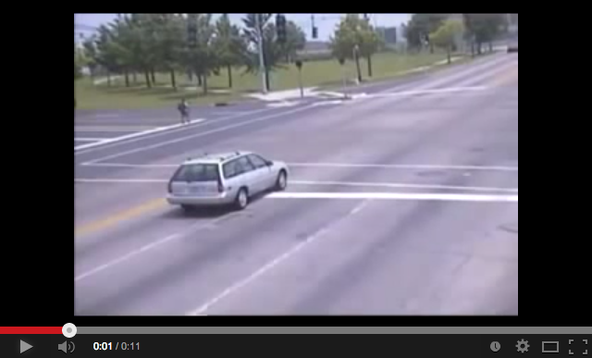
Let’s put this into play
Notes:
You can find the outline for this activity on Financial Beginnings’ website under Classroom Materials or pages 79-80 on the Presenters Guide.

Slide 23

How much money is everything in your room worth? See page 7 of the Resource Guide
Notes:
Turn to page 7 of the Resource Guide and fill in some of your most valuable items and how much they would cost to replace.
“How much would it cost to replace these items?”
“How much would it cost to replace all of your belongings?”
On average it costs about $25,000 to replace items in a two-bedroom apartment.

Slide 24
2 out of 3 renters do not have renters insurance
Costs about $10-15 a month
Covers:
  Personal property coverage
  Liability coverage
  Additional living expenses
Optional:
  Flood insurance
  Personal articles floater
Notes:
2/3 of renters do not have renters insurance. Many renters believe that if something happens their landlord’s policy will cover their belongings, but this is not true. If the rental burns down, the landlords policy will only cover the landlord’s belongings.
The cost for renters insurance is very minimal. Also, if you get renters insurance from the insurance carrier that covers your automobiles you will likely get a discount.
Covers:
Personal property coverage- This provides coverage to replace your items. You will have to decide between replacement cost vs. actually cash value (which we will talk about on the next slide) and be sure to properly document what you have.
Liability coverage- Similar to when we were talking about liability coverage on our cars. This provides for damages we cause to others.
Additional living expenses- Also covered is loss of use coverage, which means that if your apartment is not livable, say from a fire, you can be compensated for temporary housing.
Flood insurance- This insurance is provided by the US Federal Government, but purchased through your local insurance companies. When flooding occurs, we typically hear in the news that homeowners thought they were covered for floods by their policy. So if your apartment is near water and at risk of a flood, it makes sense to get this.
Personal articles floater- Uniquely valuable items (coins collections, wedding rings, artwork) are usually not protected against loss or damage in a standard policy. You can get this coverage added to your policy.

Slide 25

How much will I get for my belongings?
Actual Cash Value
$50
Replacement Cost
$1000
Notes:
“If you lose your belongings as part of a covered loss, how much will the insurance company give you for your items? “
“Let’s say you have a 3 year old laptop, how much is it worth? $50 maybe? But if you had to replace the laptop you would have to spend closer to $1000.”
Replacement coverage provides you with funds to actually replace the items instead of just providing you with their value.
Actual cash value coverage replaces the items at the value they are at the time of loss.

Slide 26
How does the insurance company know I had the laptop?
Take photos
Make a video
List the brand, model number and serial number
Store proof in safe place
Notes:
It is important to not overlook this step because otherwise the insurance company may not believe that you have the 60’ state of the art TV.
When you gather the inventory it is important that students know where a safe place to store the records is, like a safety deposit box or fire safe box.
Refer participants to Appendix B: Home Inventory Worksheet on page 14 of the Resource Guide. This worksheet can be used to help them inventory their items.

Slide 27



Back to liability
What if your dog bites the mailman?
Or you burn down the kitchen?
Or someone trips walking down your stairs?
Notes:
Homeowners insurance provides liability protection, which covers you when you are at fault for damages to someone else. So you are covered when your dog bites the mailman and the mailman has to get 10 stiches. After that claim the insurance company may exclude your dog though and not cover you if he bites anyone in the future.

Slide 28
Why health insurance?
It is the law
Medical bills largest cause of bankruptcy
No cap to exposure
Notes:
Health insurance plans are binding, legal contracts between the insurer and the insured.
Many health insurance policies have a deductible (like we talked about earlier). The deductible is the amount you are responsible for paying before the insurance company will begin to pay.
Co-payments are common for health insurance policies. A co-payment is the portion of a claim or medical expense that members of a health plan must pay out-of-pocket.
Many health insurance policies will cover the entire cost of preventative care. It is much less expensive to prevent an illness than it is to treat one.
Refer participants to Appendix D: Health Insurance Comparison Worksheet on page 16 of the Resource Guide. This worksheet can be used to compare health insurance policies.

Slide 29
Life insurance: Need it or not?
Need it! | Probably not
You have children | Single- no kids
You’re married and rely on income | Married and don’t rely on income
You own a business | Married but not employed
Your estate is over tax threshold | You’re retired
Notes:
Life insurance protects your family in case you die.
Not everyone needs life insurance. It is important to know when you do!
The table outlines when you likely need life insurance and when you probably do not.
Explain that there are life insurance policies that only pay out upon death and those are term policies. There are some insurance policies that accrue a savings and those are whole life. Term life insurance is the least expensive.

Slide 30
How much life insurance?
Needs Approach
Debts
Earnings Multiplier
Annual income * # of Years
Education
Burial
Notes:
Two common ways to determine how much life insurance you need.
Needs Approach- you add up the amount you need based on some of the following factors:
Covers immediate needs at the time of death
Dependency expenses
Debt elimination funds
Education expenses for children
Retirement income
Spousal life insurance
Immediate transitional needs
Earnings Multiplier- you determine the number of years you would like to supplement your income and multiple the number of years by your annual income.

Slide 31

Disability coverage
You are more likely to file a claim with disability insurance while you are working than life insurance.
Notes:
Disability insurance covers a portion of your income while you are unable to work due to a disability.
Short-term disability replaces a portion of ones income for a few months. An example of this is when a woman goes on maternity leave. Some employers provide this coverage.
Long-term disability replaces a portion of the income indefinitely if one becomes disabled.
When you are in early adulthood you are more likely to become disabled than you are to die. Still, many people overlook disability coverage. The cost is more expensive than life insurance because it is more likely to be used.
The cost of disability insurance can be lessened if you extend the time before the insurance starts to pay after becoming disabled and lower percentage of your income that you have the insurance supplement.
Refer participants to the Are You Covered Activity on page 12 of the Resource Guide. Allow a few minutes to complete the activity and then review the answers as a class. Answers can be found on page 86 of the Presenters Guide.

Slide 32
Ensure you have appropriate car insurance
Be sure to always have renters/homeowners insurance
Maintain health insurance
Know when you will need life insurance
Takeaways
Notes:
Review some important takeaways from the lesson with students and ask if they have any remaining questions.

Slide 33
Got it?
Do you:
  Understand what insurance is, why you need it and how it works?
  Understand what insurance premiums are and how they are determined?
  Know what liability coverage is and how it applies to auto and renters/homeowners insurance policies?
  Can you explain the different types of insurance and when they apply to real life?
  Understand insurance contracts and the major decisions that have to be made when purchasing policies?
Notes:
Review the insurance objectives and fill in any gaps that may have been missed.

