Slide 1

Welcome
COUNTRY Financial® proudly provides financial literacy education to your classroom.
Financial literacy is important, no matter how old you are and
no matter your goals. Understanding money allows you to make
more informed choices and to be better able to pursue your
dreams. Congratulations on taking this first step in becoming
more financially savvy.
Sponsored by

Slide 2
Financial Foundations
Banking
A Financial Beginnings Financial Education Program
©
2015 Financial Beginnings
Notes:
Take the time to introduce yourself including who you work for and details of your job. If you are not working then share with them why you are passionate about teaching them about banking.

Slide 3

What is banking?
Notes:
Start the conversation with student by asking “what is banking?”
This is a great opportunity to start your discussion with students and find out what their experiences are surrounding banking.

Slide 4

Bank--Verb vs. Noun
Notes:
When we are talking about banking today it is important to understand how the term is used.
Banking is the verb for your interacting with a bank or credit union.
When we refer to a “bank” it includes a bank, credit union or savings & loan institution. We will go more into the difference between a bank and credit union later on.

Slide 5
What are we doing today?
We will:
  Learn about differences between banks and credit unions.
  Learn how to choose the right bank or credit union for you.
  Find out the benefits and services that financial institutions provide.
  Learn how to avoid banking fees.
  Lean how to calculate the different types of interest.
Notes:
Course objectives for Banking.

Slide 6

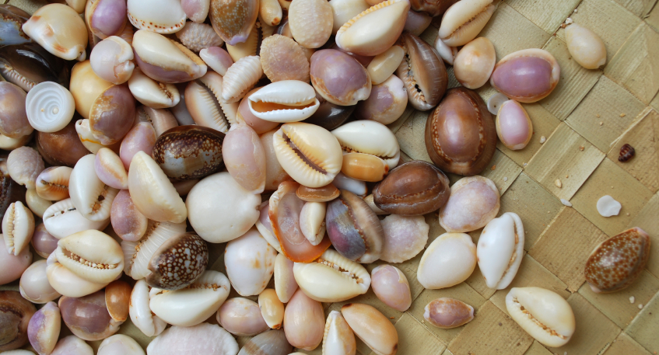

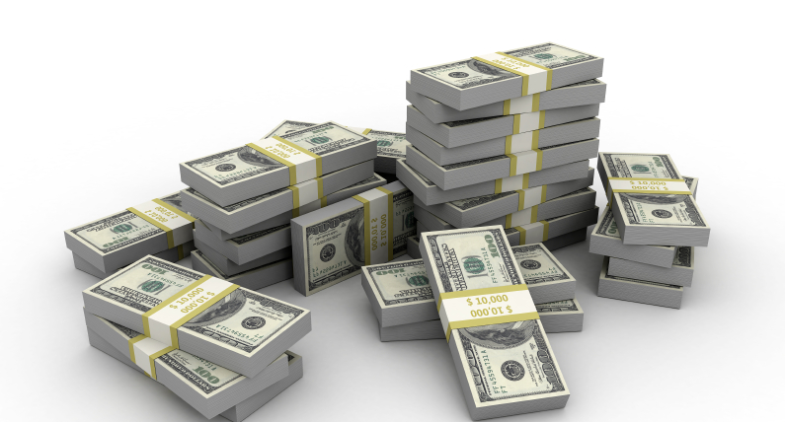
What is money?
Durable- Transportable- Dividable- Hard to counterfeit
Notes:
Money is anything that members of a community accept in exchange for goods or services. Money is:
A medium of exchange
A measure of value
A store of value
Money needs to be:
Durable- Doesn’t easily break
Transportable- Can be moved easily
Dividable- Can be broken down into smaller amounts
Hard to counterfeit- Can’t easily be duplicated
Provide examples of some currency that has been used. For each example ask students if the form of currency is Durable? Transportable? Dividable? Hard to counterfeit?
Cow- Not just cows but other forms of livestock have been used as forms of currency.
Shells- Cowrie shells is the most widely and longest used currency in history.
Gold- It used to be that all paper notes were backed by actual gold. In 1933 the United States moved away from the gold standard.
Currency today- We are continually updating our currency to try to prevent against counterfeit.
“Where do you think currency is heading? In the digital age do you think our currency stay how it is now?”

Slide 7
Banks and Credit Unions
Banks
Credit Unions
For profit
Operate to serve shareholders
Pay taxes
May have more branches
May have more products to offer as larger institution
Not-for-profit
Operate to serve members
May have more competitive interest rates
May have lower fees
Notes:
Explain to students the differences and similarities between Banks and Credit Unions and why it is important to have a bank account.

Slide 8
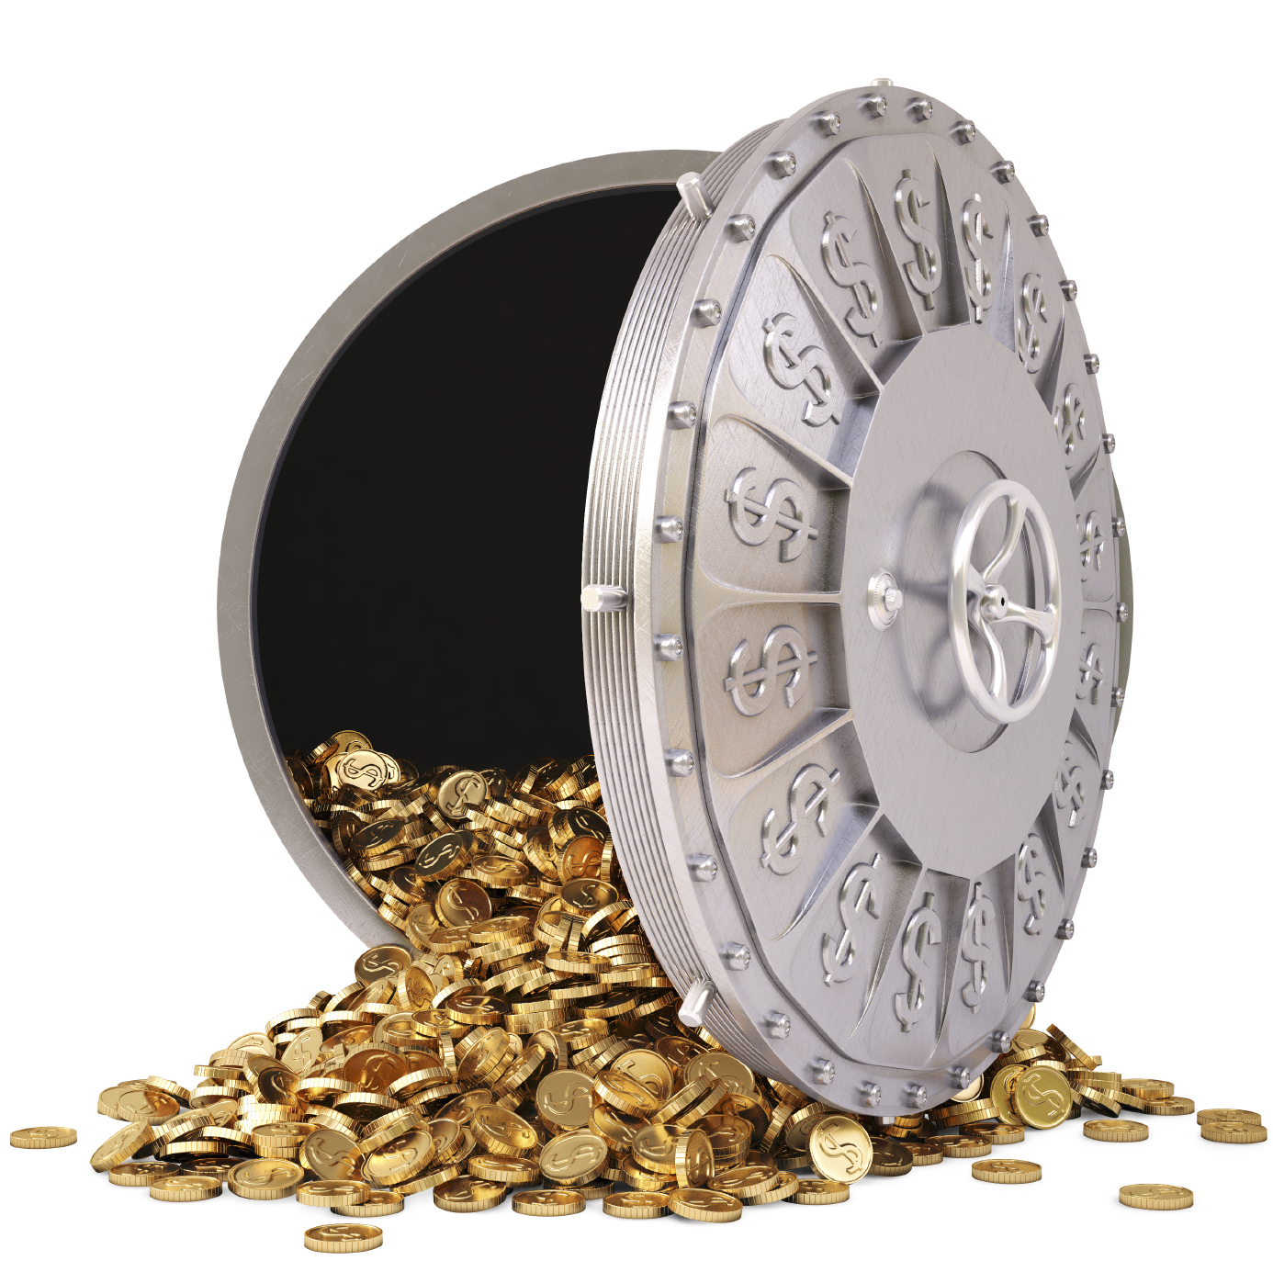
The banking process
Notes:
When we were young, many of us were introduced to banking and were pointed out the vault which held our money when visiting the bank.
“When you put your money into the bank do they safely store it in the vault for you until you need it? “
No, they actually utilize the funds to lend out to other people for loans to buy cars, houses or other items. The bank will pay a small interest percentage to you for keeping your money in the bank and allowing them to, in turn, lend it out to someone else for a high rate. This is one of the ways they make money to operate their business.
“But if they’ve lent out my money, how do I know I’ll get it back? “
Both banks and credit unions are regulated to ensure that your money is safe. You are insured up to $250,000 at each bank or credit union. If you have more money than this in the account you may consider diversifying by putting anything over $250,000 into another bank or credit union.
The Federal Deposit Insurance Corporation (FDIC) is backed by the government and provides protection for accounts held at banks.
The National Credit Union Share Insurance Fund is backed by the government and provide the insurance for credit unions.

Slide 9
Why use a bank or credit union?
Notes:
Refer students to the top of page 5 of the Resource Guide and ask them to take a few minutes to fill in some of the reasons to maintain a bank or credit union account. Ask students to share their answers and lead a discussion on the benefits of having an account.
It keeps your money safe.
It can provide proof that you paid your bill.
It makes it easier to track and manage your money.
It allows you to build a relationship with a financial institution.
It can save you money on check cashing or money orders.

Slide 10
How to compare financial institutions
What benefits does the financial institution offer?
What are the financial institution’s fees and policies?
What kind of accessibility do they offer?
What is important to you?
See Appendix A: Choosing a Bank or Credit Union on Page 13
of the Resource Guide
Notes:
What benefits does the financial institution offer?
Are there minimum balance requirements?
Will they waive monthly fees?
Do they have higher interest rates on savings?
Do they have lower interest rates on loans?
What are the financial institution’s fees and policies?
What is the cost of over drafting?
Is there a monthly fee? If so, how much? Is there a way to avoid the fee?
Are there fees associated with falling below minimum balance?
What kind of accessibility do they offer?
Where are they located?
How many locations are there?
Is there online banking?
Are there convenient ATM locations?
What is important to you?
Student discounts?
Locations?
Hours of operation?
Fees?
Online or mobile banking?

Slide 11
Account A | Account B | Account C
Monthly Fee: $10 or waived if: Direct deposit over $500 $1,500 minimum daily balance $5000 in checking and savings | Monthly fee: $0 | Monthly fee: $0
Minimum Balance: $0 | Minimum Balance: $50 to open and $0 after | Minimum Balance: $0
Interest %: 0% on checking, .01% on savings | Interest %: 0% on checking and .05% on saving | Interest %: .25%
ATM fee: $0 at their ATMs and $2 at others | ATM fee: $0 at theirs or many partners, $3 others | ATM fee: $0
Locations: Practically on every corner | Locations: Not convenient for you | Locations: Online only
Mobile Banking: All the bells and whistles | Mobile Banking: Basic, no photo deposit | Mobile Banking: All bells and whistles
Notes:
Here are 3 different institutions accounts. Which would be best for:
Someone that kept a low balance and was a total techie?
Someone that had their paycheck direct deposited and liked to speak with a real person when they banked?
Someone who just wanted the best interest return on their money?
Page 14 of the Resource Guide is Appendix B: Bank Account Review. You can direct students to this to complete on their own time or possibly the teacher can assign as homework. This allows students to compare checking or savings accounts from different institutions similarly to the above slide.
Page 15 of Resource Guide is Activity: Monica & Sarah. This activity allows students to see how bank account fees can quickly add up and why it is important to choose an account that is right for them.

Slide 12
What you will need to open an account:
Photo identification
Another form of identification like a credit card
Proof of address
Your SSN or ITIN
Don’t forget the money!

Slide 13
Checking vs. Savings Accounts
Checking
Savings
Manages your daily spending
Can withdrawal via check, debit, or ATM
Sometimes accrues interest
For your savings; like emergency fund or short term goals
Always accrues interest
Limited withdrawals
Notes:
Lead students through a discussion explaining the differences between checking and savings accounts.

Slide 14
How is interest calculated?
Annual Percentage Rate (APR)
But usually not calculated annually. Could be daily, monthly, quarterly, or annually.
Do you know the APR on your savings account?
1%
12 months
.08% monthly
Notes:
“Do you know how much interest you are receiving on your savings account?”
“How often are you paid interest on your savings account?” Explain to students in order to calculate interest that is compounded monthly they have to divide the annual interest rate by 12.
The example in the slide assumes a 1% APR compounded monthly.

Slide 15
Simple vs. Compound Interest
Notes:
Simple Interest- Interest paid or earned only on the principle amount.
Compound Interest- Interest earned on paid on principle and accrued interest.
The example is based on the figures in the table on page 7 of the Resource Guide. It is comparing $100 at 5% calculated with simple vs compound interest.

Slide 16
Other Accounts and Services
Overdraft Protection
Certificates of Deposit (CD)
Online Banking
Safe Deposit Box
Mobile Banking
Notes:
Online Banking
Ability to view account balances and transfer money between accounts 24 hours a day.
Online bill pay services.
The ability to transfer money to other accounts or account holders.
Budgeting tools.
Overdraft Protection
The bank will honor a purchase you have made even though you do not have the money in your account.
This is now an “opt in” service.
It can cost $30-40 for each overdraft item.
As an alternative you can link your savings account to checking account and it will automatically take money from your savings when there are not enough funds. The cost is usually much less than overdraft fees.
Certificate of Deposit (CD)
An account in which you agree to leave your money on deposit for a specific amount of time in exchange for earning a higher interest rate than you would on a savings account.
The longer and more money you agree to deposit, the higher the interest rate earned.
There’s a catch! If you take the money out before the end of the term you may be subject to fees and/or paying back interest paid to you.
Safety Deposit Box
A drawer within a vault at the bank.
Store important documents such as; passports, titles, jewelry, birth certificates.
Are a low cost and are provided for free with some accounts.
Mobile banking
Remote deposit, by taking a photo of the check.
View account balances.
Bill payment.
Transfer funds.
Find ATMs or branches.

Slide 17
Managing your accounts
The responsibility is yours!
Notes:
You have a responsibility to ensure that you maintain your accounts. It is important to watch your account carefully in order to:
Help identify bank errors
Catch unauthorized charges
Prevent identify theft
Track spending habits
If you do find that you have a problem with your account you should:
Contact your bank ASAP to discuss the problem
Write down the name of the person who helped you
Offer a solution and ask the bank to correct the problem
Do not lose your temper
If you are not satisfied with the solution, write a letter to a manager summarizing the situation and what you want to happen

Slide 18
Ways to Manage Your Account
Online banking
Spreadsheet
Accounting software
Online programs
Register
Notes:
Online Banking- Most banks and credit unions allow you to access your account online at anytime. You may be able to categorize your spending, pay bills online and even access accounts from other institutions.
Spreadsheets- Excel or Numbers can be used to easily manage your account. You can create formulas, which will do the math for you.
Accounting Software- Quicken and Quickbooks are examples of accounting software you can purchase to keep track of your money.
Online programs- Many free money management programs have been created and many have phone applications to go along. Mint.com costs nothing and allows you to pull in information from all of your institutions and easily see your net worth and manage a budget.
Register- The classic check register is still a powerful tool to manage your account balance, even if you find you do not write checks.

Slide 19
Can you believe your account balance?
Current balance
Outstanding deposits
Available Balance
Outstanding purchases
Reconciling a bank account:
Notes:
With the speed that technology moves now it is, more than ever, easy to determine your available balance. It is important to understand that when you are looking at the balance listed on your account, it may not mean that you have that much available to spend.
Outstanding deposits- Sometimes when you deposit a check in your account the bank will put a hold on the check to ensure it can be cashed. You may not be able to use those funds for a few days.
Outstanding purchases- Some purchases still require a check, like possibly your rent. It can take time for that check to clear (say you send it in the mail, then the landlord takes a couple of days to go to the bank and deposit it). It is important to take into account the outstanding purchases that may not be showing in your current bank balance.
Keeping track of your available balance will ensure that you do not overdraw your account. Many bank accounts will provide you tools to watch your balance, like sending you texts or emails when your account balance falls below a specified amount.

Slide 20
Avoid fees!
Save on ATM fees
Track your spending
Set up direct deposit
Ask for occasional fee reversal
Notes:
Save on ATM fees- Use your own bank or their partners’ ATMs so you don’t have to pay a fee. If you are not able to avoid it, then take out larger sums less often. Some stores will allow you to take cash back. You can purchase a pack of gum and get the cash back for free.
Keep track of your spending- If you keep track of your spending you will ensure that you do not overdraft your account and you will be aware of your purchasing habits.
Set up direct deposit- Direct deposit is very convenient and many times the the bank will waive the monthly fee if you utilize it.
Ask for the occasional fee reversal- If you overdraft your account and have never done it before, many times they will reverse the fee for you as a courtesy. It doesn’t hurt to ask. The worst they can say is “no”.

Slide 21
Debit vs. Credit Cards
Debit Card
Credit Card
Available on all checking accounts, young as 13
Your money
No interest payment
Usually requires PIN
If fraudulent activity have to wait to get money refunded
Does not build credit history
Have to be 21, or 18 with a co-signer
Borrowing from future
Pay interest on unpaid balance
Easier to dispute fraudulent charges
Card rewards
Builds credit history
Notes:
Usually by this point students understand the difference between debit and credit cards, but it is still beneficial to dig into the topic because many times they do not know all of the differences.
It can be fun to pull out some credit and debit cards from your wallet and ask students which are the credit cards and which are the debit cards.
Both have:
a Visa or MasterCard logo
16 numbers
an expiration date

Slide 22
Identity Theft
Dumpster Diving
Skimming
Phishing
Changing Your Address
Old-Fashioned Stealing
Pretexting
Notes:
Dumpster Diving- going through others’ trash looking for bills or other paper with personal information on it
Skimming- stealing credit/debit card numbers by using a special storage device which reads and saves personal information acquired during a legitimate transaction
Phishing- pretending to be financial institutions or companies and send spam, pop-up messages or even call you to get you to reveal personal information
Changing Your Address- divert billing statements to another location by completing a change of address form
Old-Fashioned Stealing- stealing wallets and purses, mail, including bank and credit card statements, pre-approved credit offers and new checks or tax information. They steal personnel records, or bribe employees who have access.
Pretexting- using false pretenses to obtain your personal information from financial institutions, telephone companies, and other sources.
If you printed the Identity Theft Activity from the Volunteer Website, you can now allow students to complete the activity. The following slides will act as either a review or can be used to walk through some scenarios as a group.

Slide 23
Phishing
You get a call from the IRS letting you know that there is an issue with your tax return filing, but before they can discuss the matter with you they request you verify your social security number and mailing address.

Slide 24
Skimming
You go to an ATM to deposit your paycheck and notice the card reader seems thicker than it was the last time you were there, like there is an extra layer of plastic on it.

Slide 25
Pretexting
You get an email from your credit card company letting you know your password has been changed, but you did not change it. You call and find out that some had called in and administered the reset process on your account.

Slide 26
Dumpster Diving
You are going out for a morning jog and notice someone going through your neighbor’s recycling bin.

Slide 27
Old-Fashioned Stealing
You come back to you hotel room after spending the afternoon at the pool to find your wallet is missing.

Slide 28
Changing Your Address
You have not received your credit card statement in a couple of months and you find out there has been mail theft in your neighborhood.

Slide 29
Don’t Be a Victim
Shred it!
Don’t give out account information, including passwords and PIN’s
Report fraud immediately
Don’t carry your social security card
Watch accounts for irregularities
Notes:
Shred unneeded financial institution documents rather than simply throwing them away.
Be careful who you give your account information to.
If you notice changes to your account that you did not make, contact your bank as soon as possible. If your information has been stolen contact all of your financial institutions as soon as possible to try and mitigate additional fraud.
Do not not carry your social security card or bank account information in your wallet or purse.
Do not share your passwords or PIN with anyone (even close family and friends). Do not make your passwords or PINs easy for someone to guess.

Slide 30
Maintain a Good Relationship
Or you’ll be sorry!
Notes:
It is important to maintain a good relationship with your bank. Failure to do so can affect your ability to have an account in the future.
ChexSystems is the major national account verification company used to check your banking history. When you apply for a new account your ChexSystems report will be pulled and any abandoned accounts, unpaid checks or other banking mistakes will be listed.
You can get a copy of your ChexSystems report if:
You have been denied a bank account in the past 60 days because of information provided by ChexSystems
Your checks were stolen and used by an imposter or you are the victim of any bank fraud
You are entitled to one free report each year

Slide 31
Notes:
Inflation means that the general prices of goods and services are increasing. When inflation is rapid, the prices of goods and services can increase faster than consumers’ income, and that means the amount of goods and services consumers are able to purchase goes down.
Inflation is calculated by comparing the Consumer Price Index or CPI. The US Bureau of Labor calculates the CPI by determining the change of a group of specific items used by consumers.
The table shows the CPI over the last 100 years. The good news is Hersey Bars have actually increased at a price less than inflation. 100 years ago one could buy a Hersey Bar for $.02 and now they can purchase one for $99. If it had followed the CPI the Hershey Bar would cost over $3.

Slide 32
Banking BINGO
Page 16 of the Resource Guide
Notes:
Refer students to page 16 of the Resource Guide to play a fun game of BINGO.

Slide 33
Takeaways
Know how to choose the right account
Avoid fees!
Don’t be a victim of identity theft
Understand interest

Slide 34
Got it?
Do you:
  Know how to explain the difference between banks and credit unions?
  Understand how to choose the right bank or credit union for you?
  Understand the benefits and services that financial institutions provide?
  Understand how to avoid banking fees?
  Know how to calculate the different types of interest?

